Slide 1

ADVANCED DESIGN OF CONCRETE STRUCTURES
Analysis and design of cable stayed bridge.
Siva Rama Krishna Nallajarla - CE24M309
Department of Civil and Environmental Engineering,
Indian Institute of Technology Tirupati, Andhra Pradesh 517619, INDIA

Slide 2
TABLE OF CONTENT
1. INTRODUCTION TO CABLE BRIDGE
2. TYPES OF CABLE BRIDGES
3. DESIGN PHILOSOPHY
4. PROBLEM STATEMENT
5. SOFTWARE USED
6. PRELIMINARY DESIGN
7. MATERIALS AND SPECIFICATIONS USED FOR THE BRIDGE
8. LOADS AND LOAD COMBINATIONS
9. MODELING
10. ANALYSIS
11. RESULTS
12. CHECKS
13. DESIGN
14. DETAILING
15. REFERENCE

Slide 3
1. INTRODUCTION TO CABLE BRIDGE
A cable-stayed bridge is a type of suspension bridge in which the bridge deck is directly supported by cables (or stays)
that are connected to one or more vertical pylons or towers.
Why Cable stayed bridges?
It has higher stiffness (Bending & Torsional stiffness)
Volume of traffic needs to be catered
Self-supporting structure
Concrete compressive strength can be utilized to its maximum
Deck undergoes more compression during live load which is very unlikely in other kind of bridges

Slide 4
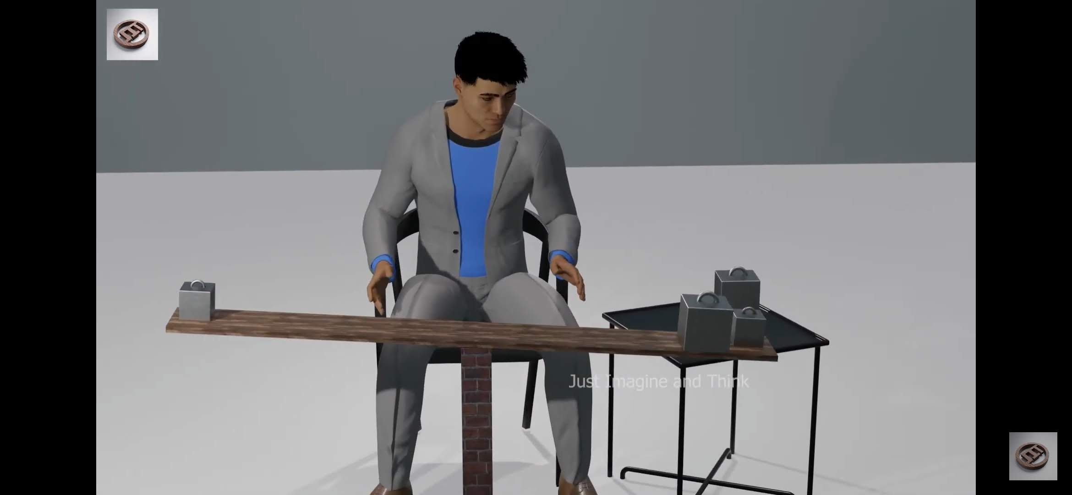
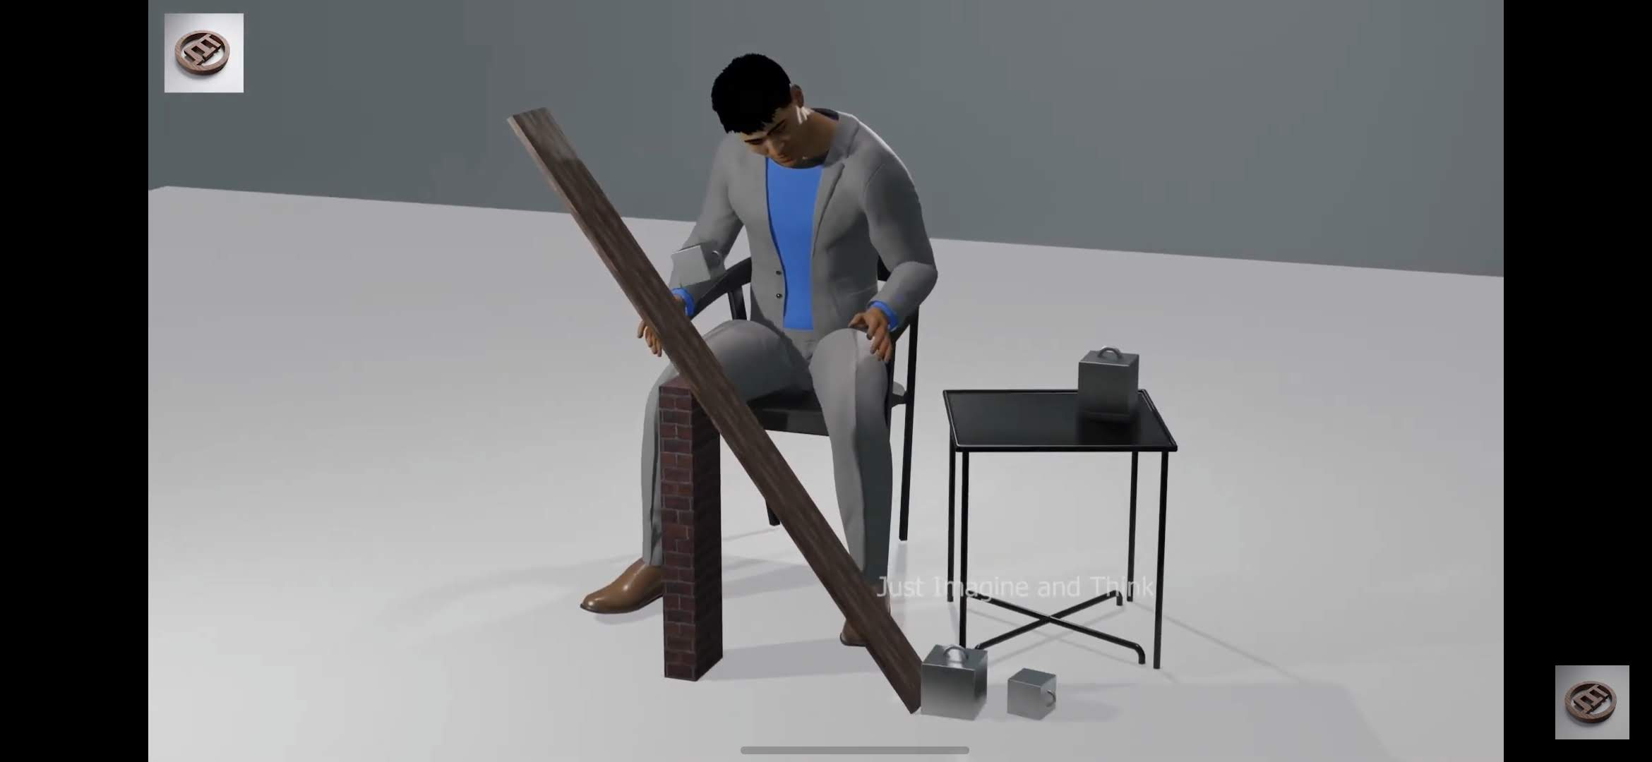
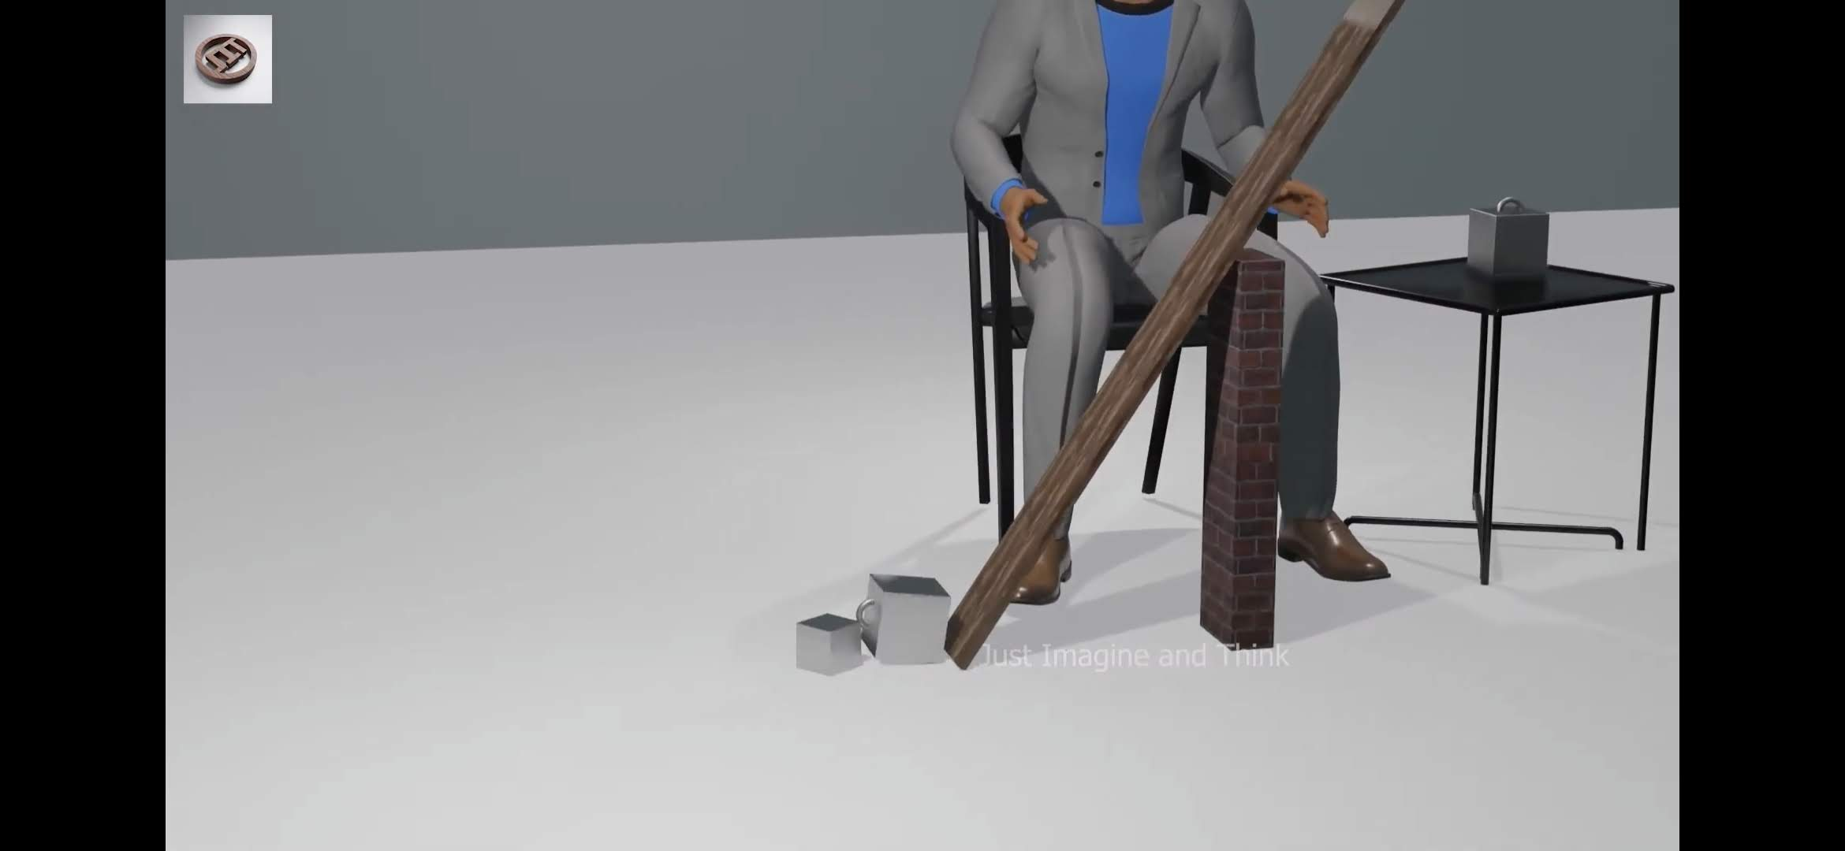
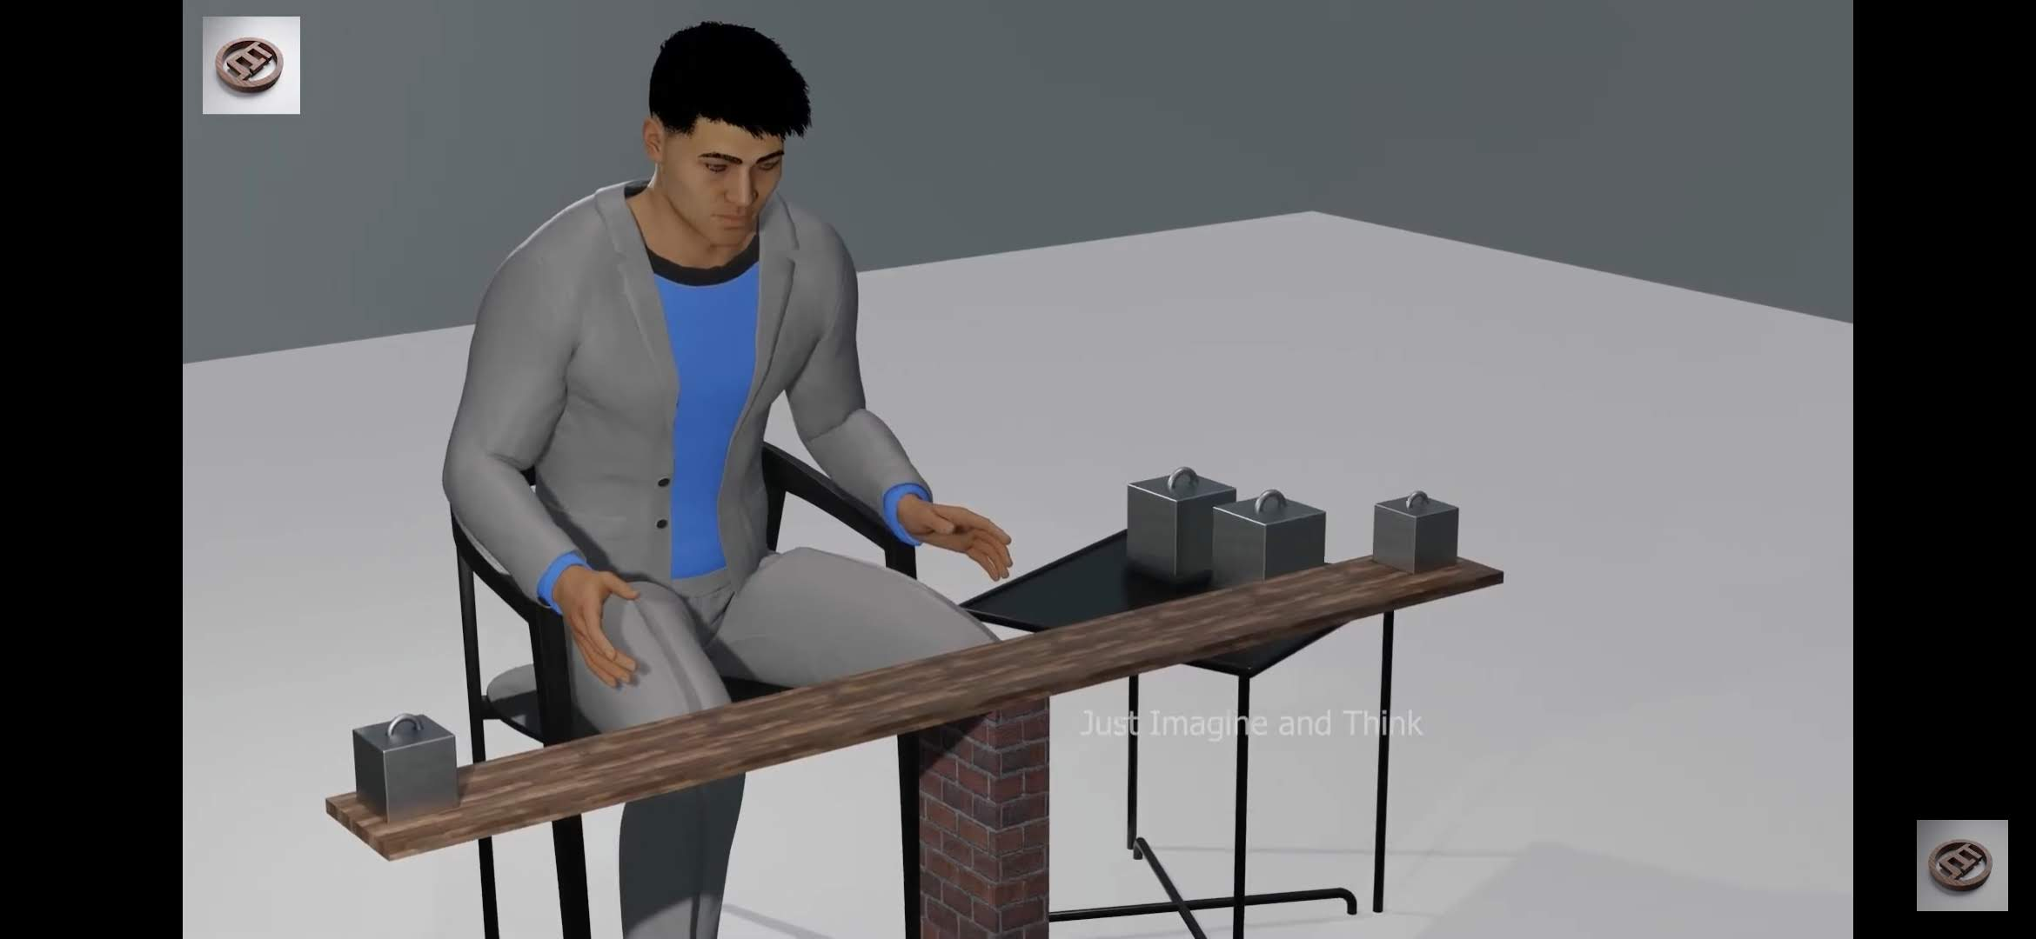
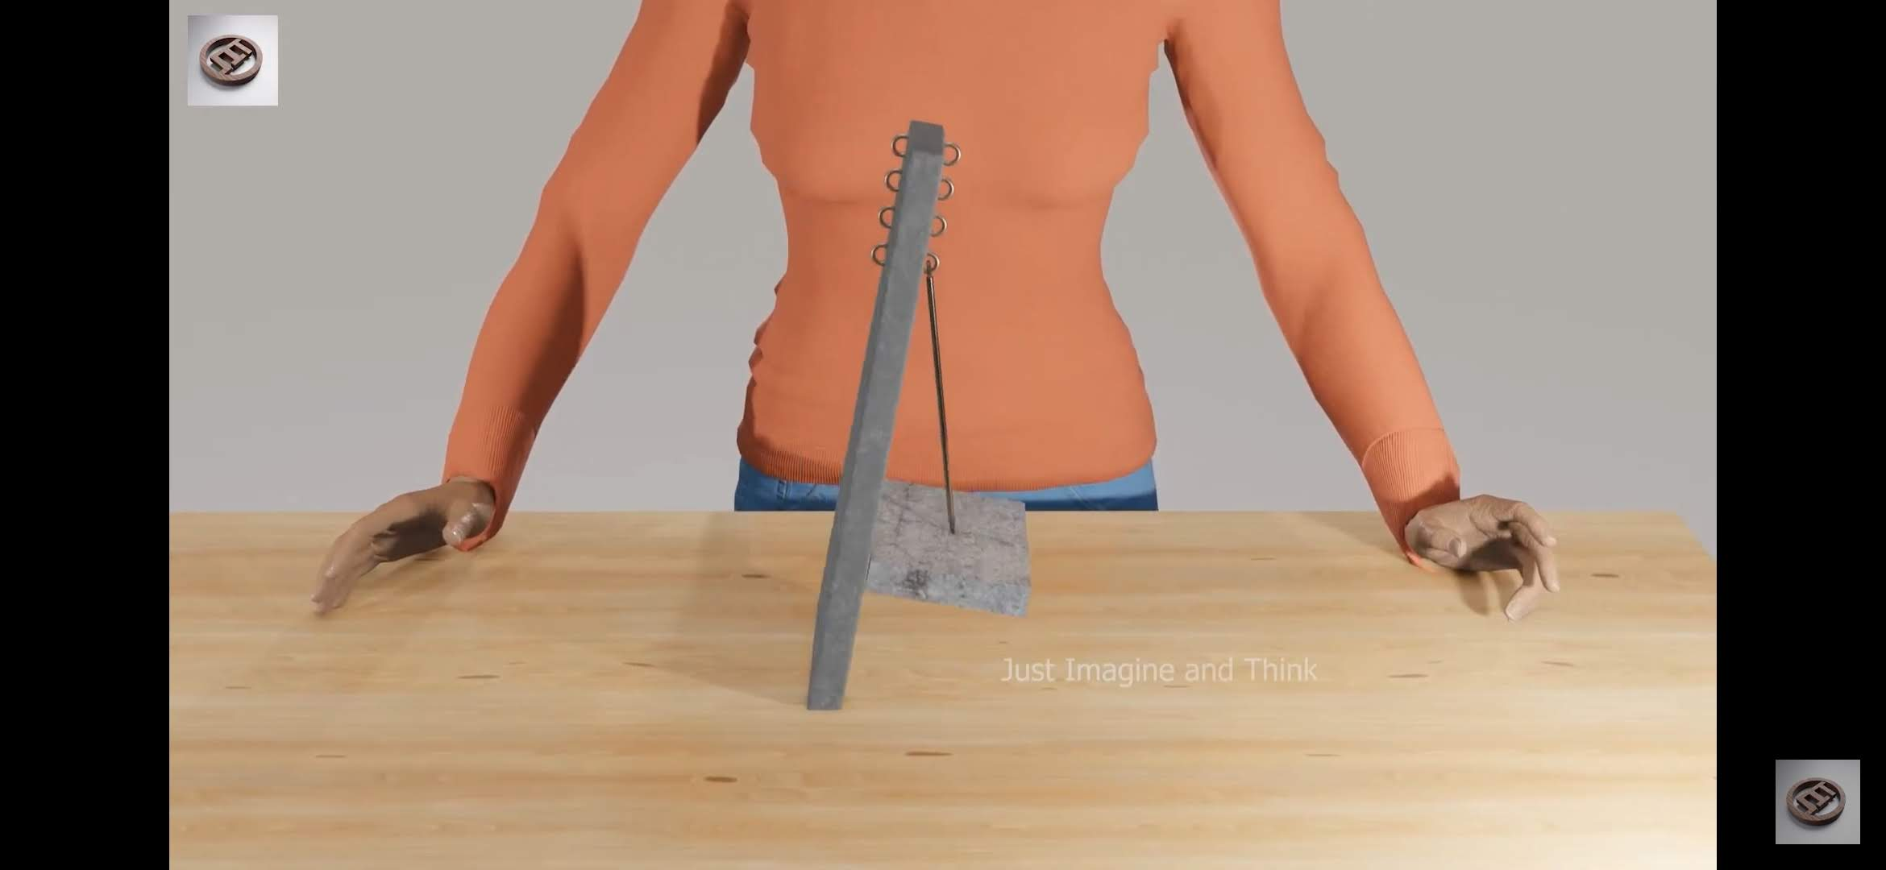
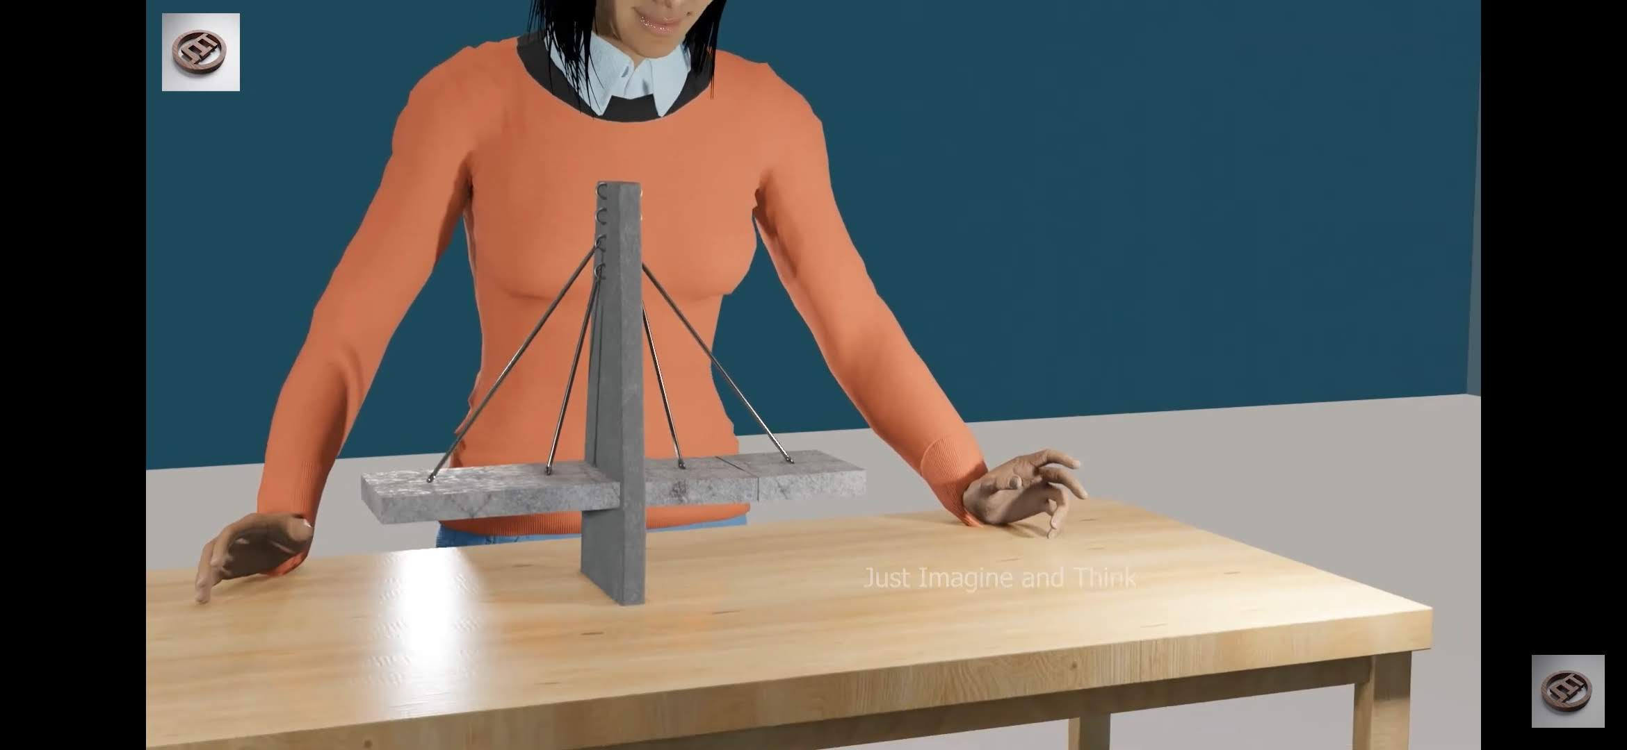
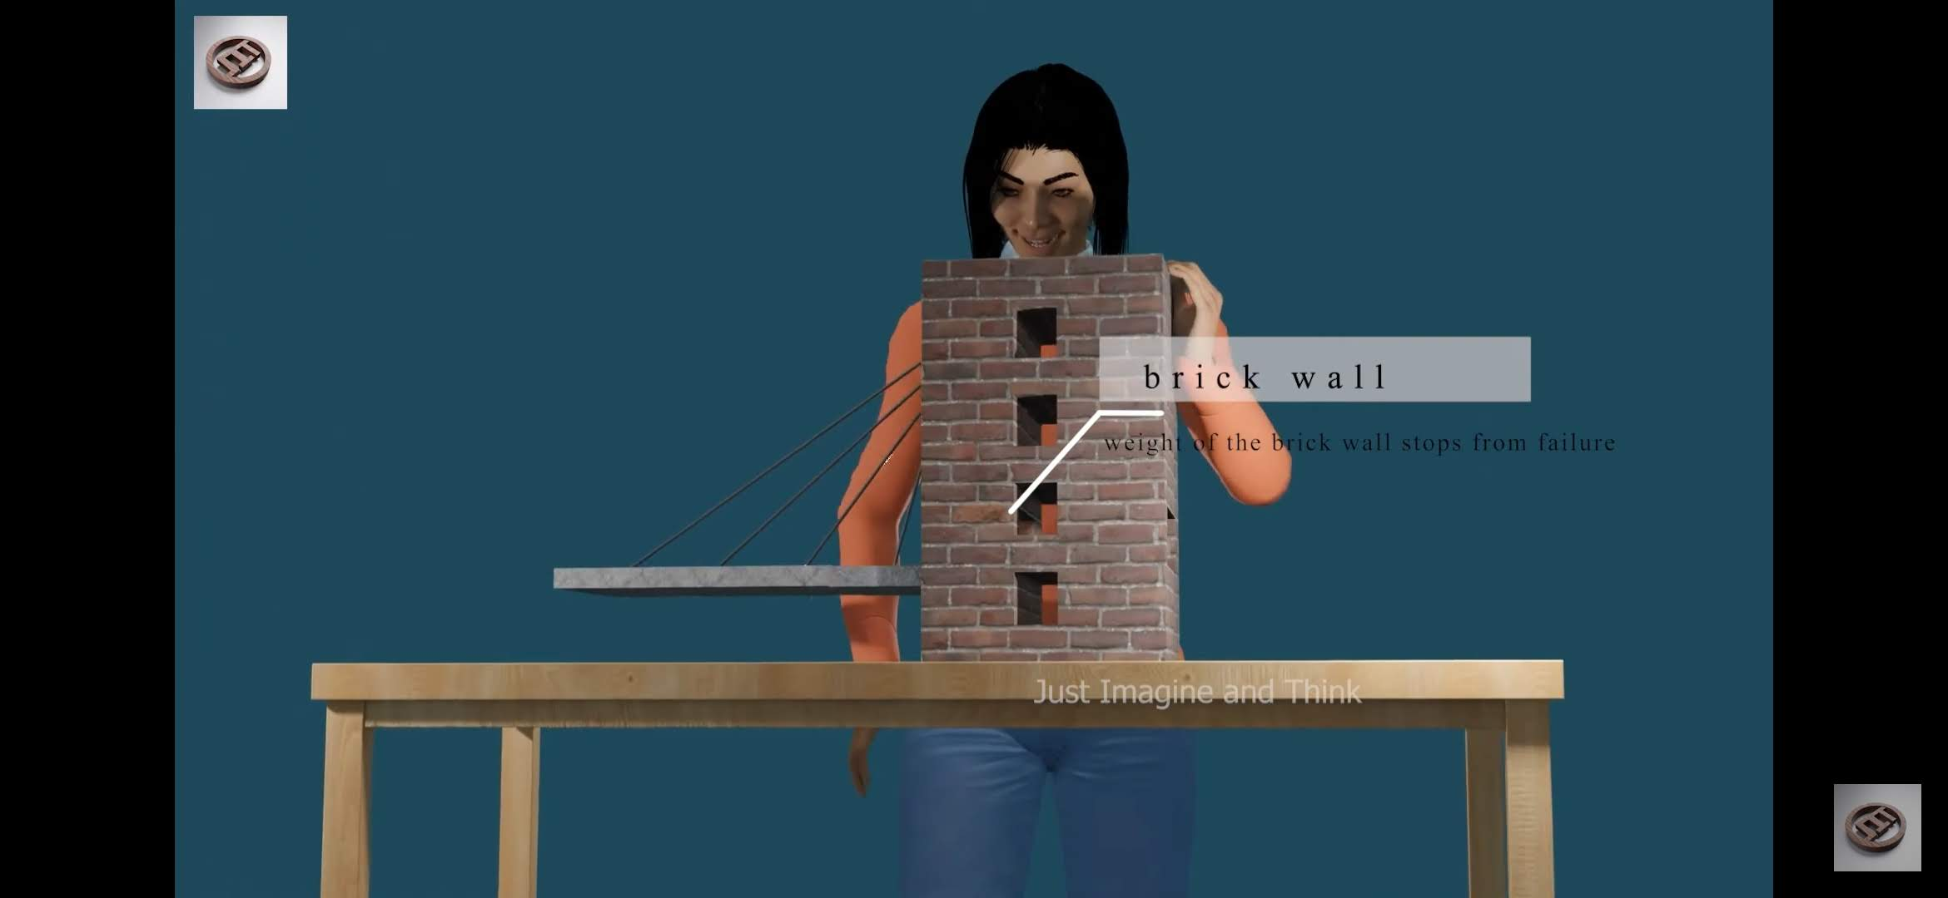
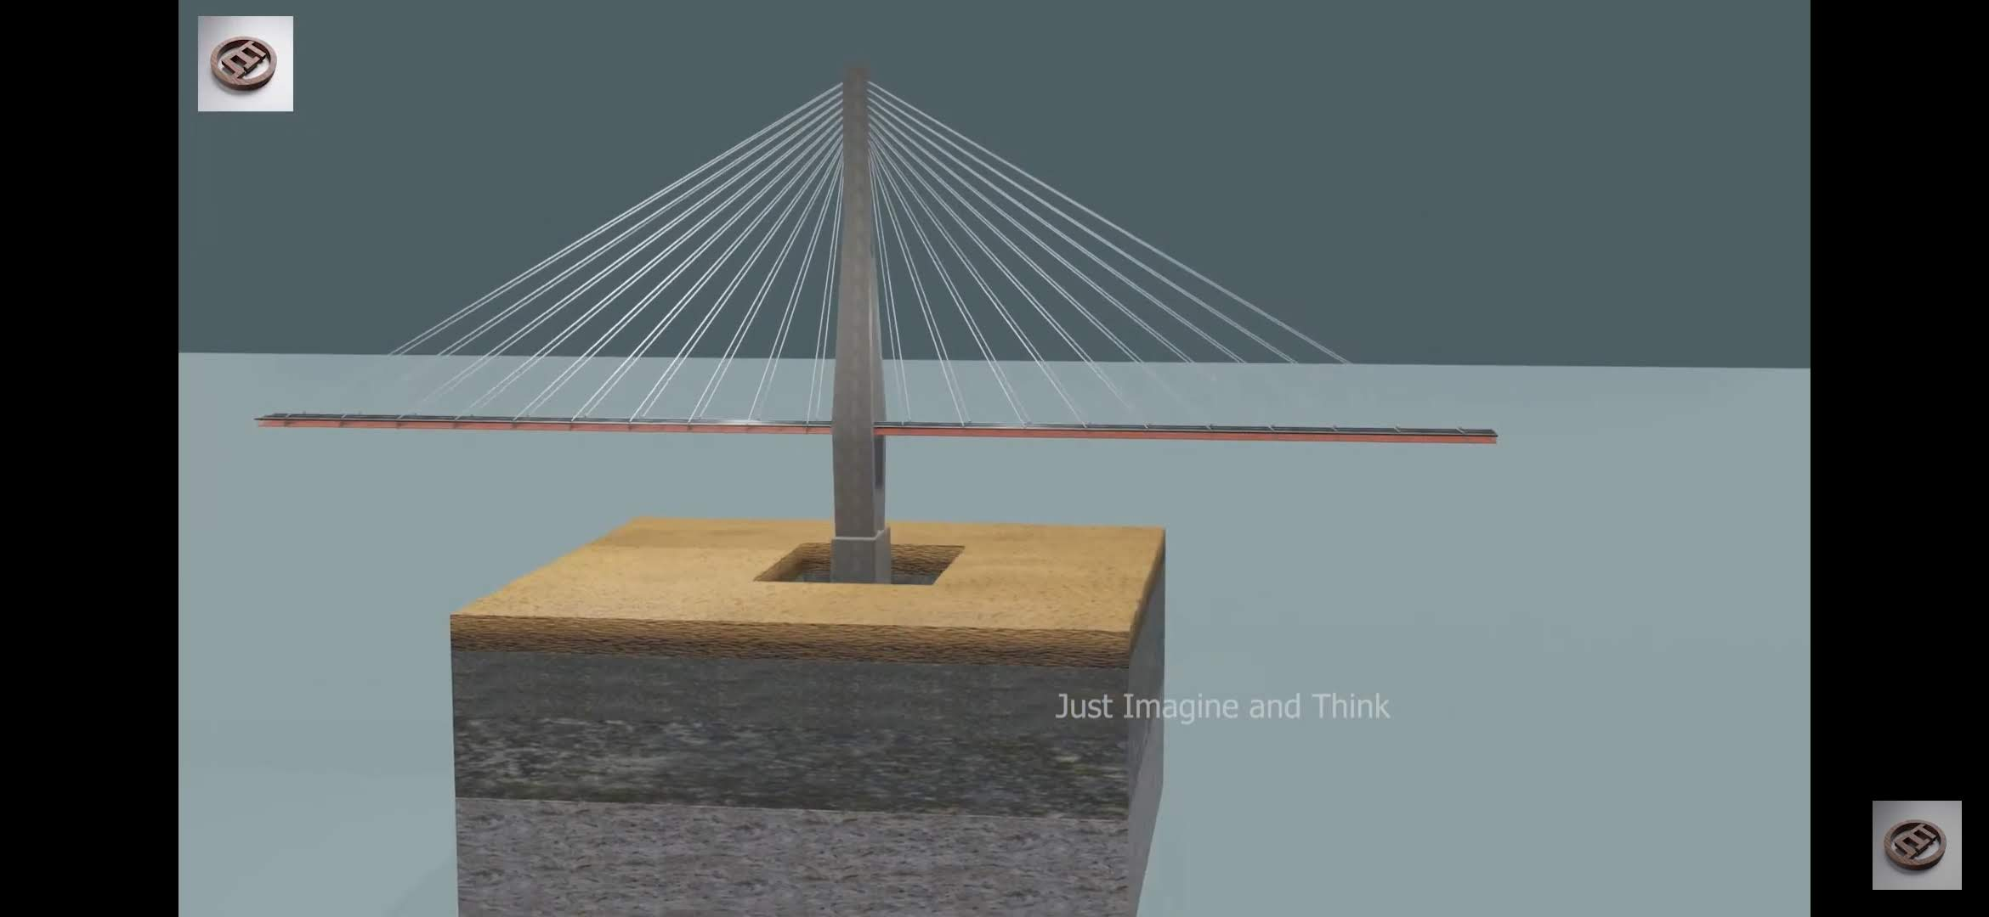
1.2 CABLE BRIDGE WORKING PRINCIPLE
2
3
4
1
5
6
7
8
Reference imagine and think

Slide 5
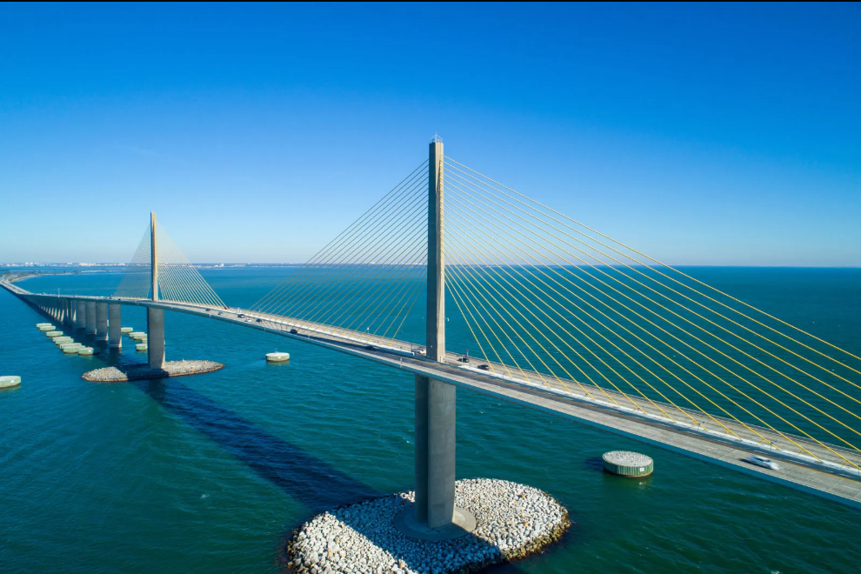
1.3 COMPONENTS OF CABLE BRIDGE
1)WELL FOUNDATION
2)PYLON
2.1) UPER PYLON
2.2) LOWER PYLON
3)PIER TABLE
UPPER PYLON
CABLES
DECK
4)CABLES
5) DECK
6) TENDONS
7) BEARINGS
PIER TABLE
LOWER PYLON
WELL FOUNDATION

Slide 6
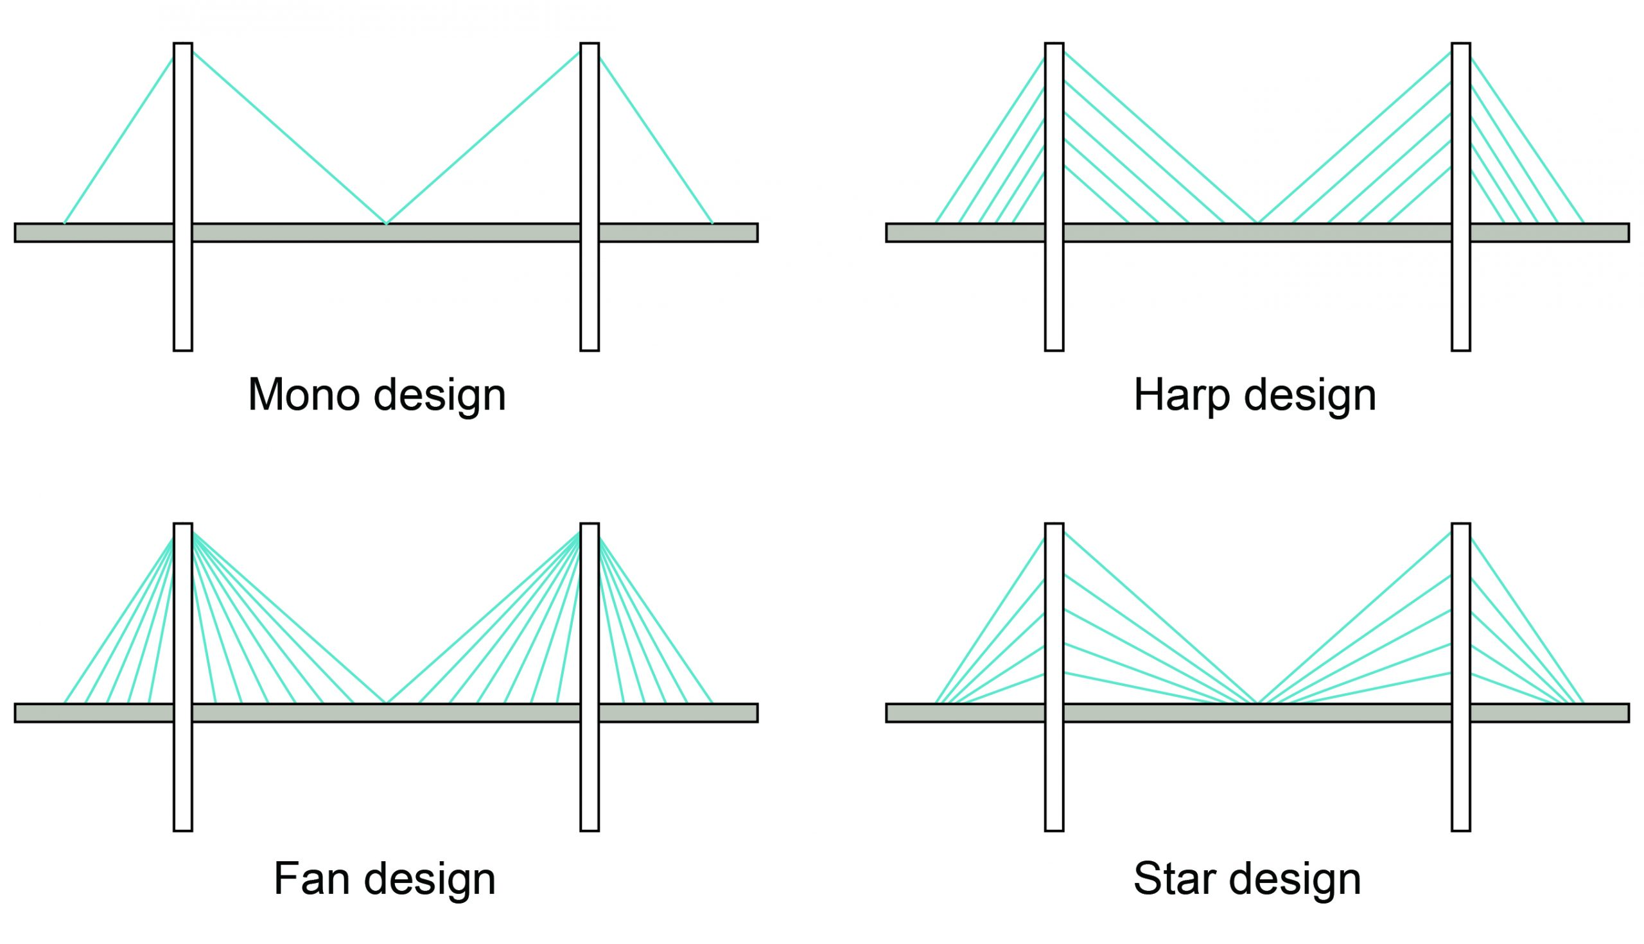
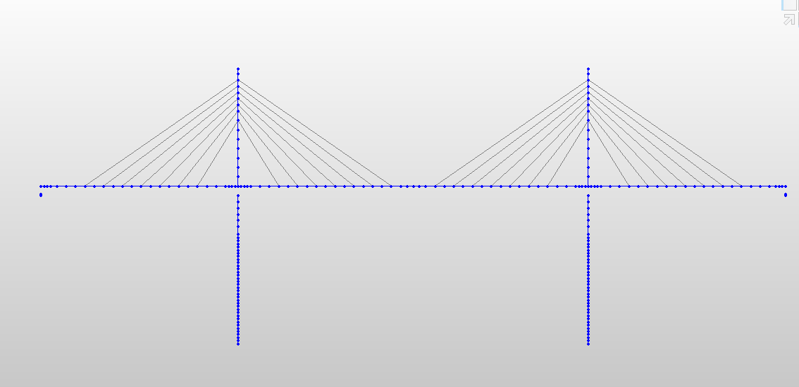
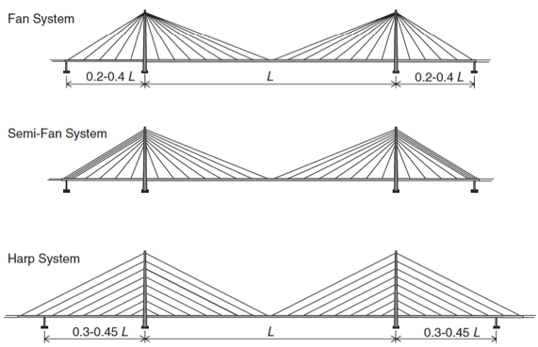
2. TYPES OF CABLE-STAYED BRIDGE
2.1 DEPEND ON CABLE-STAID SYSTEM
CHOSSED CABLE PROFILE
SEMI FAN SHAPE

Slide 7
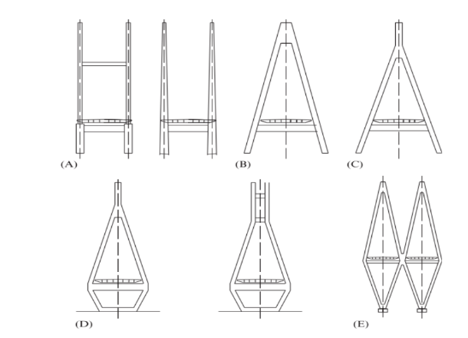
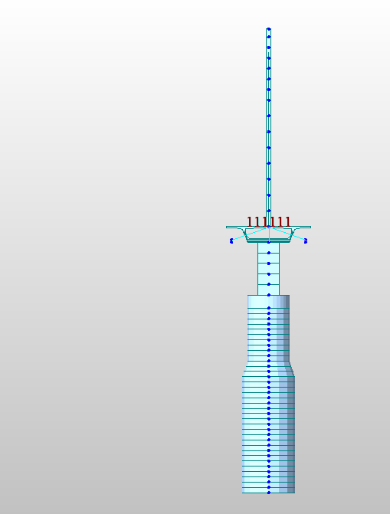
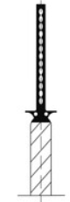
2.2 DEPEND ON PYLON TYPES
H FRAME
A FRAME
INVERTED Y-FRAME
NEEDLE PYLON CHOOSED
DIAMOND PYLON
TWIN DIAMOND PYLON
SINGLE LEG OR NEEDLE SHAPED

Slide 8
2.4 LOAD TRANSFER MECHANISM IN CABLE BRIDGE
DECK
BOTTOM PLUG
CABLES
SOIL STRATA
PYLONS
LOWER PYLON
WELL CAP
WELL STEININIG
WELL CURB
CUTTING EDGE

Slide 9
3. DESIGN PHILOSOPHY
Finding the value of cable tension that will give optimum deck profile for the final model.
Backward construction stage analysis to find cable forces during erection.
Forward Analysis for checking the final pretension values and also for considering time-dependent effects.
Final checks with seismic, wind and other effects.
Construction stage analysis is carried using FEM software including the nonlinearity of member and the time-dependent factors.
Bridge sections are approximated according to the experience in the design of cable-stayed bridges in the past.
A symmetric section is chosen for analysis of the bridge.
Preliminary analysis is done to check whether the approximation is under the acceptable criteria for deflection and shear. As per the provision of the code use the following method. Deflection and stress variation is determined in each stage of Construction. Adjustment in cable forces and length of the cable according to the deformed profile obtained in each stage until the desired profile is achieved.

Slide 10
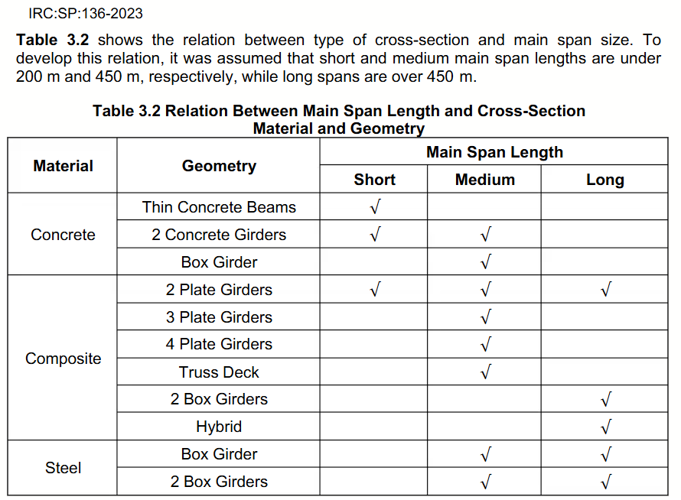
4. PROBLEM STATEMENT
NAME OF THE PROJECT – ANALYSIS AND DESIGN OF CABLE-STAYED BRIDGE
BRIDGE CONFIGURATION – TWO NEEDLE PYLONS AND SEMI-FAN SHAPED CABLES.
TYPE OF ROADWAY – TWO-LANE ROAD
DECK – PSC BOX GIRDER
SPAN OF THE BRIDGE – 238M
LOCATION OF SEISMIC ZONE – II
LOCATION OF SOIL – HARD ROCK OR HARD SOIL

Slide 11

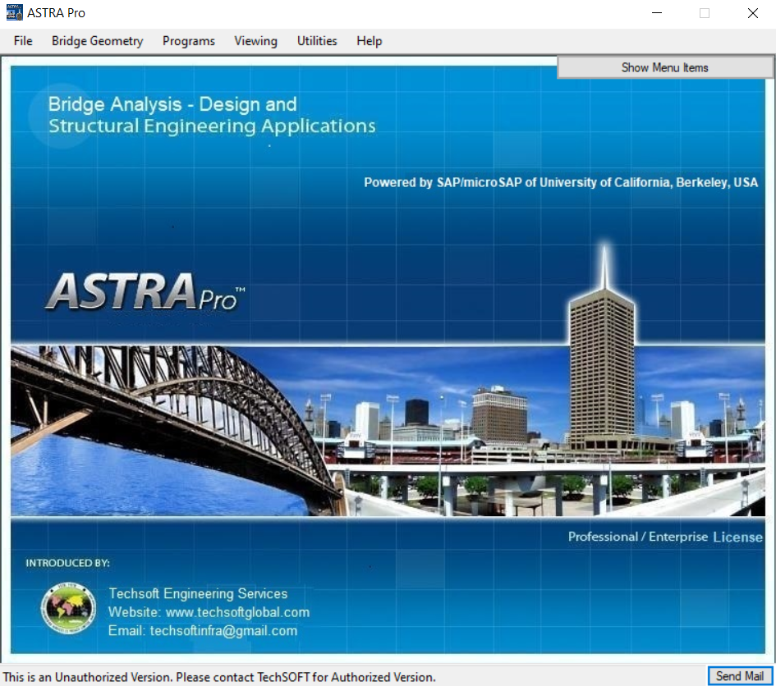


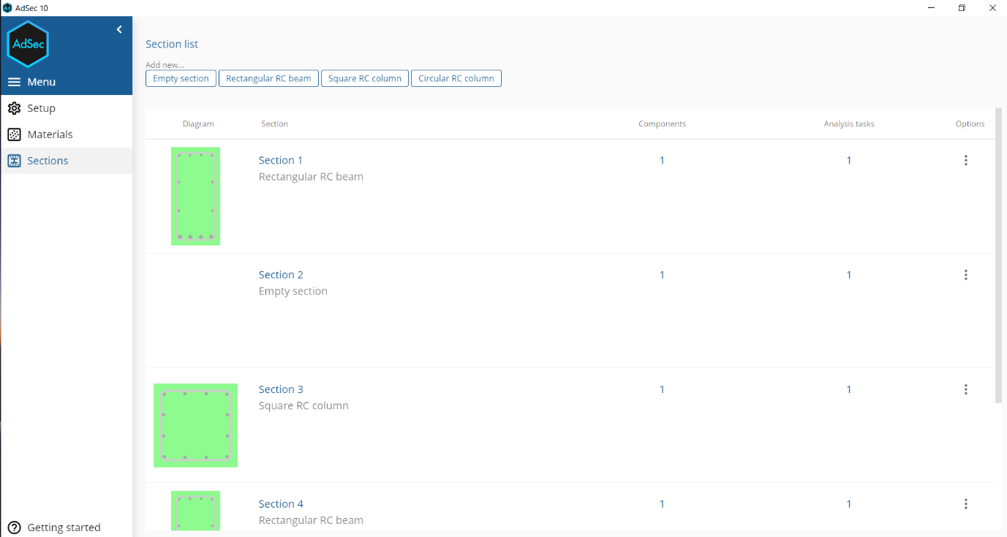

5. SOFTWARES USED
5.1 MIDAS CIVIL
5.2 ASSTRA PRO
FOR MODELING AND
ANALYSIS
FOR SECTION DESIGN
5.3 AD SEC 10.0
5.4 AUTOCAD
5.5 MS EXCEL
FOR CALCULATIONS
AND SECTION DESIGN
FOR SECTION DESIGN
FOR DETAILING

Slide 12
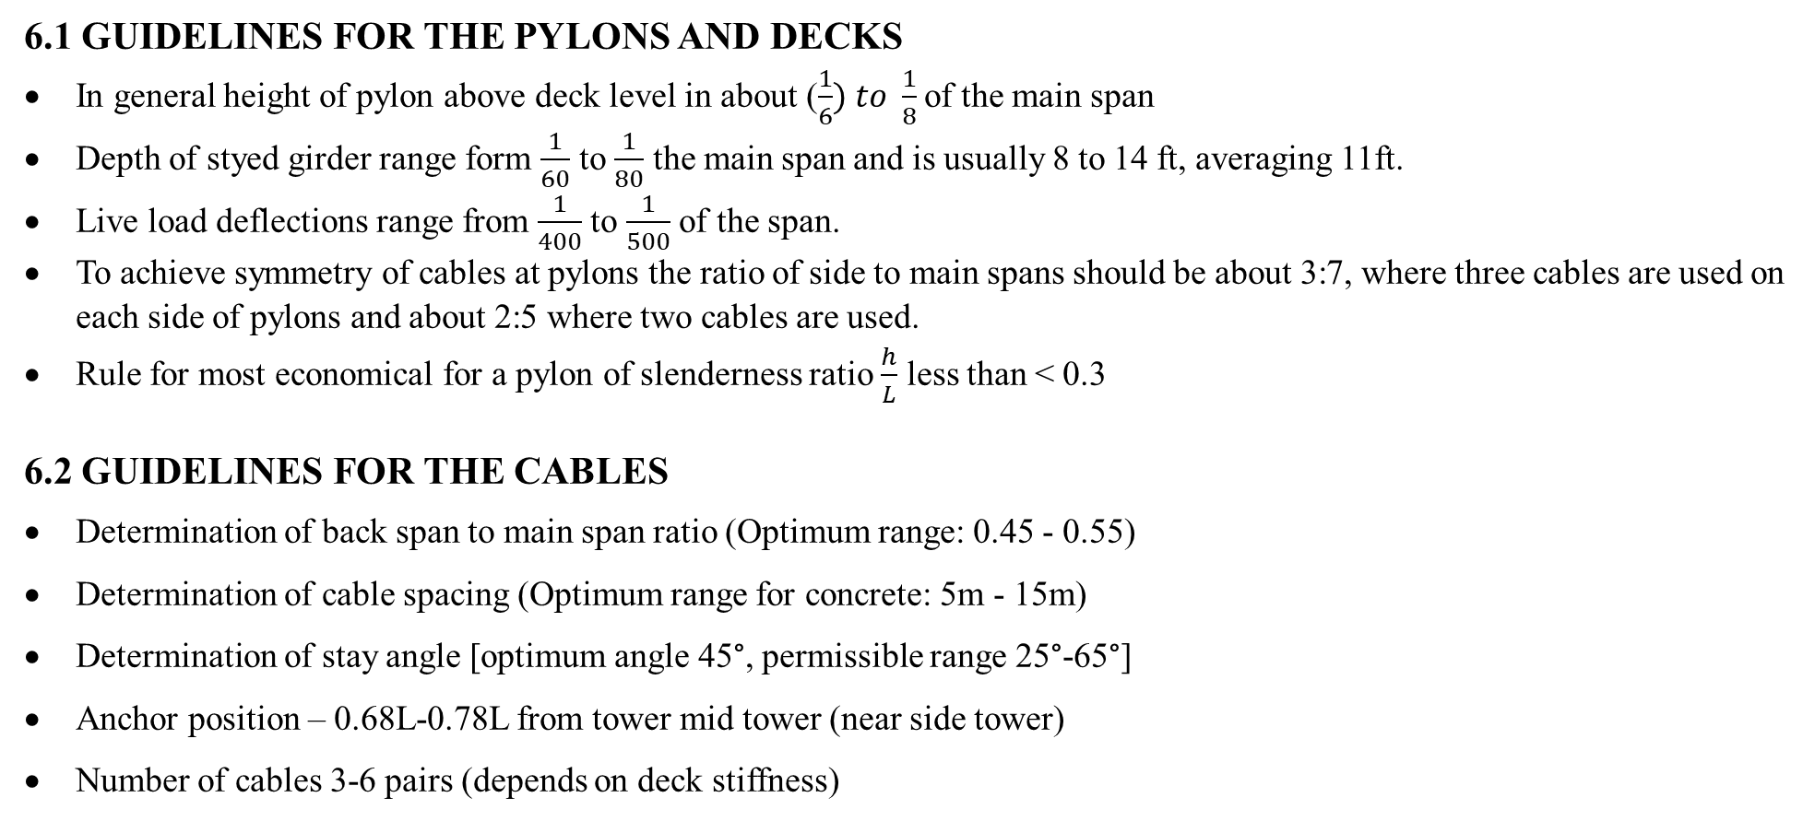
6. PRELIMINARY DESIGN OF CABLE BRIDGE
6.1 GUIDELINES FOR THE PYLONS AND DECKS
In general height of pylon above deck level in about ($\frac{1}{6}) to \frac{1}{8}$ of the main span
Depth of styed girder range form $\frac{1}{60}$ to $\frac{1}{80}$ the main span and is usually 8 to 14 ft, averaging 11ft.
Live load deflections range from $\frac{1}{400}$ to $\frac{1}{500}$ of the span.
To achieve symmetry of cables at pylons the ratio of side to main spans should be about 3:7, where three cables are used on each side of pylons and about 2:5 where two cables are used.
Rule for most economical for a pylon of slenderness ratio $\frac{h}{L}$ less than < 0.3
6.2 GUIDELINES FOR THE CABLES
Determination of back span to main span ratio (Optimum range: 0.45 - 0.55)
Determination of cable spacing (Optimum range for concrete: 5m - 15m)
Determination of stay angle [optimum angle 45°, permissible range 25°-65°]
Anchor position – 0.68L-0.78L from tower mid tower (near side tower)
Number of cables 3-6 pairs (depends on deck stiffness)

Slide 13
6.3 PRELIMINARY DIMENSIONS OF CABLE BRIDGE.
UPPER PYLON
CABLE
3.5
DECK
3
37.5
14
14
18
14
2.5
10
3
6
LOWER PYLON
8
9
8
12.5
50.5
3
WELL STEINING
PIER TABLE
22
63
112
63
WELL FOUNDATION
7 CABLES ON EACH SIDE
14 PER PYLON
28 TOTAL CABLES
ALL DIMENSIONS ARE IN M
DIAGRAM IS NOT TO SCALE

Slide 14
7.0 MATERIAL AND SECTIONS FOR BRIDGE
7.1 SECTIONS GIVEN IN MIDAS CIVIL
Deck (mid span) – PSC
Deck at pier – PSC
Lower pylon
Upper pylon
Well cap
Well steining
Anchor cable
Tendon.
7.2 MATERIALS USED
Lower pylon concrete M60
Upper pylon concrete M60
Deck M60
Well M40
Well steining M30
Anchor cable - steel
Tendons - steel

Slide 15
8. LOADS AND LOAD COMBINATIONS
8.1 TYPES OF LOADS ON BRIDGE
9. Secondary loads
1. Dead load
2. Superimposed dead load.
2.1 SIDL fixed
2.2 SIDL variable
3. Live load (vehicle load and pedestrian load)
4. Wind load
5. Seismic load
6. Temperature load
6.1 Temperature uniform (TU)
6.2 Temperature gradient (TG)
7. Breaking force
8. Pretension
Creep
Shrinkage
1. SIDL – Fixed:
These loads are permanent and unchanging over time.
Wearing course (bituminous or concrete surfacing)
Waterproofing layer
Railings/parapets/crash barriers
2. SIDL – Variable (sometimes called semi-permanent):
These are non-structural loads that may vary over time or be replaced during maintenance.
Asphalt overlay (may change with resurfacing)
Removable utility lines

Slide 16
8.2 DEAD LOADS
Density of reinforced concrete – 2kn/m3
Density of steel for cables and tendons is 7850 kg/m³
Density of wearing course is 2300 kg/m³
Railings 1.5 kN/m
Light towers 1.5 kN per unit
Median 6 kN/m
Footpath 4.0 kN/m²

Slide 17
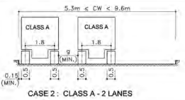

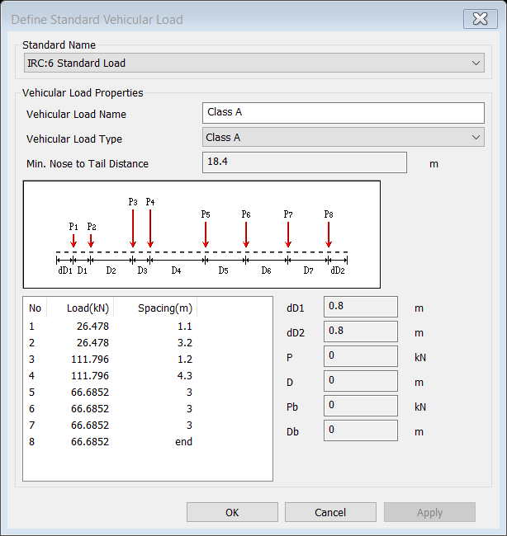
8.3 VEHICLE LOAD AND ECENTRICITY
8.3.1 CLASS A LOADING
CLASS A 55 TONS
TABLE 6A
vehicle
Median
1.8
0.5
1.8
Crash barrier
Wearing coat
0.075
0.5
0.15
0.5
0.5
0.15
0.5
PSC box girder
8
8
16
Eccentricity e = 2.45 m
All dimensions are in m

Slide 18
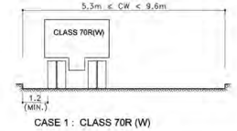
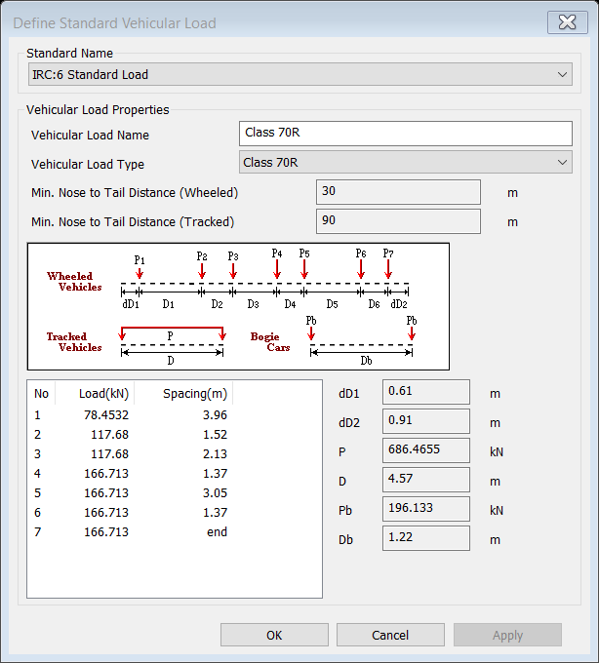
8.3.2 CLASS 70 R LOADING
vehicle
Median
1.8
0.5
1.8
Crash barrier
Wearing coat
0.075
0.5
1.2
PSC box girder
8
8
16
Eccentricity e = 3.2 m
All dimensions are in m

Slide 19
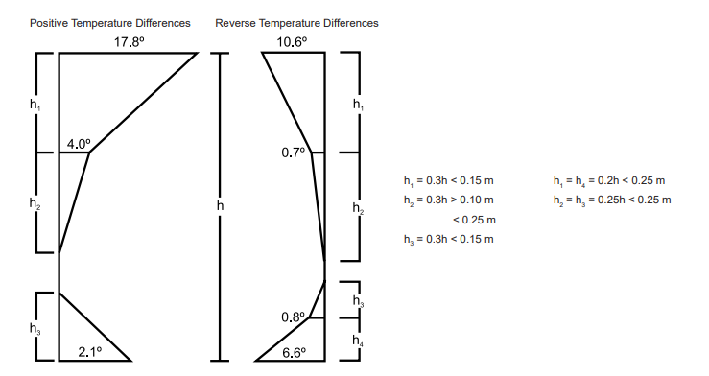
8.4 PEDESTRAIN, BREAKING, AND TEMPERATURE LOAD.
8.4.1 BREAKING FORCE
From IRC 6 2017 CI 209.6
Breaking force is taken as 20 percentage of live load
The maximum live load on the bridge is 166.13 KN
Breaking force = 0.2 x 166.13 = 33.226 KN
8.4.3 TEMPERATURE LOAD ON THE GIRDER
From IRC 6 2017 CI 215.4
8.4.2 PEDESTRIAN LOAD AS PER IRC:6-2017
Live Load on pedestrian path or footpath: 5.0 kN/m² (or 500 kg/m²)

Slide 20
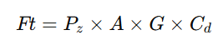
8.4 WIND LOAD
IRC:6-2017 – Clause 209.3.5
8.4.1. WIND LOAD WITHOUT LIVE LOAD
Transverse Wind Load (Ft)
3. WIND LOAD ON VEHICLES (LIVE LOAD)
Fl=25%×Ft=0.475≈0.5kN/m
Transverse Wind Load (Ft)
4. WIND LOAD ON SUBSTRUCTURE
(PIERS/COLUMNS)
Ft =5.27kN/m
Longitudinal Component (Fl)
Ft=463.7×4×1.425×2=5.28kN/m
Fl=0.25×Ft=1.32kN/m
8.4.2. WIND LOAD WITH LIVE LOAD
Superstructure Wind Load:
Fv=510×16×2×0.75=12.24kN/m

Slide 21
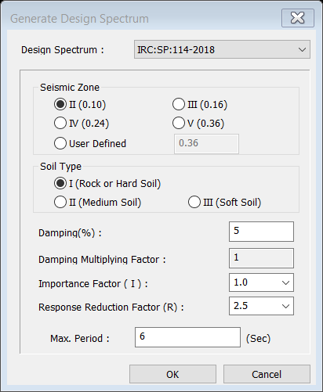
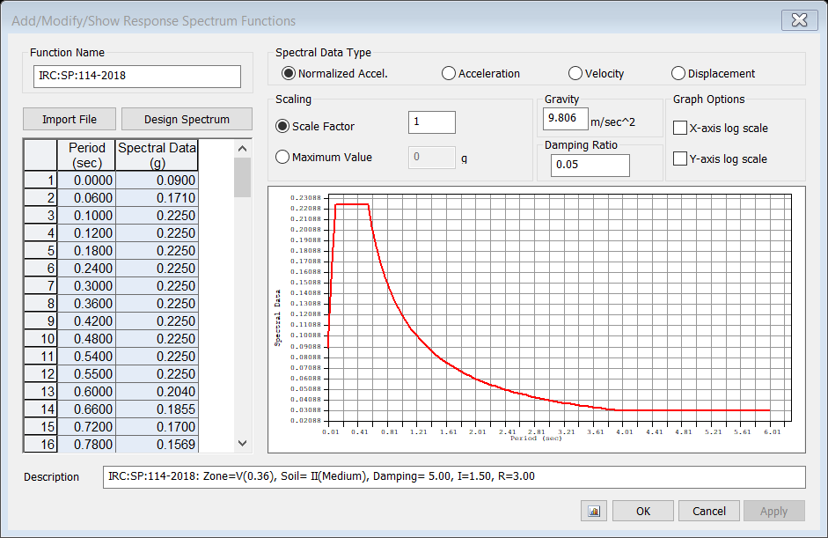
8.5 SEISMIC DEFINITION.
8.5.1 PARAMETERS GIVEN IN THE MIDAS SEISMIC DEFINITION.
• Design Spectrum: IRC: SP:114-2018
• Seismic Zone: II (Zone factor, Z = 0.10)
• Soil Type: Type I (Rock or Hard Soil)
• Damping (%): 5%
• Damping Multiplying Factor: 1.0
• Importance Factor (I): 1.0
• Response Reduction Factor (R): 2.5
• Maximum Period: 6 seconds

Slide 22
8.6 LOAD COMBINATIONS
2 Limit state of serviceability.
Serviceability Load Factors (IRC:6-2017 Table 4)
1. Limit state of strength.
Table 4 of IRC:6-2017
Load Type | Leading (γf1) | Accompanying (γf2)
DL, SIDL | 1.35 | 1.0
LL | 1.5 | 1.15
Wind | 1.5 | 0.9–1.5 (case based)
Temp | 0.9–1.5
Braking Force | 1.5
Seismic Load | 1.2
Load Type | Partial Safety Factor (γf)
Dead Load (DL) | 1.0
SIDL Fixed/Var. | 1.0
Live Load (LL) | 1.0
Wind Load (WL) | 1.0
Temperature | 1.0
Braking Force | 1.0
Seismic (EQ) | 1.0

Slide 23
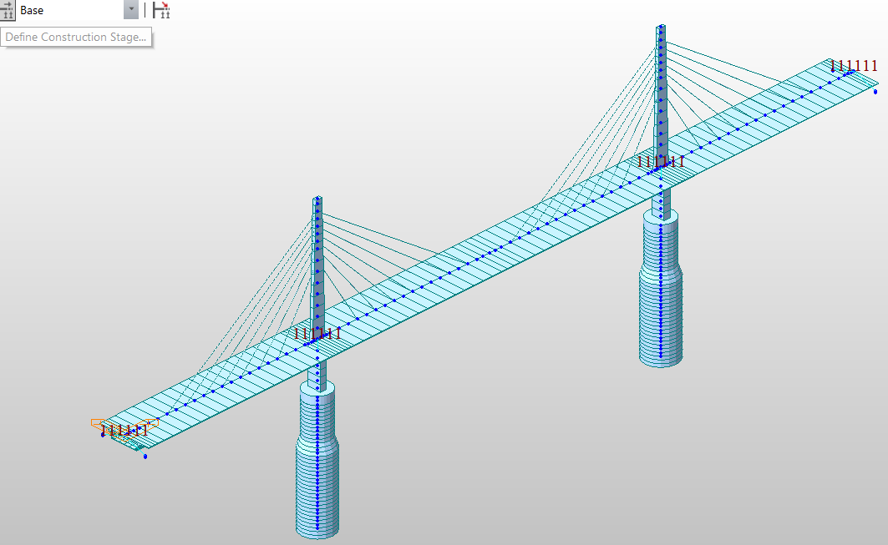
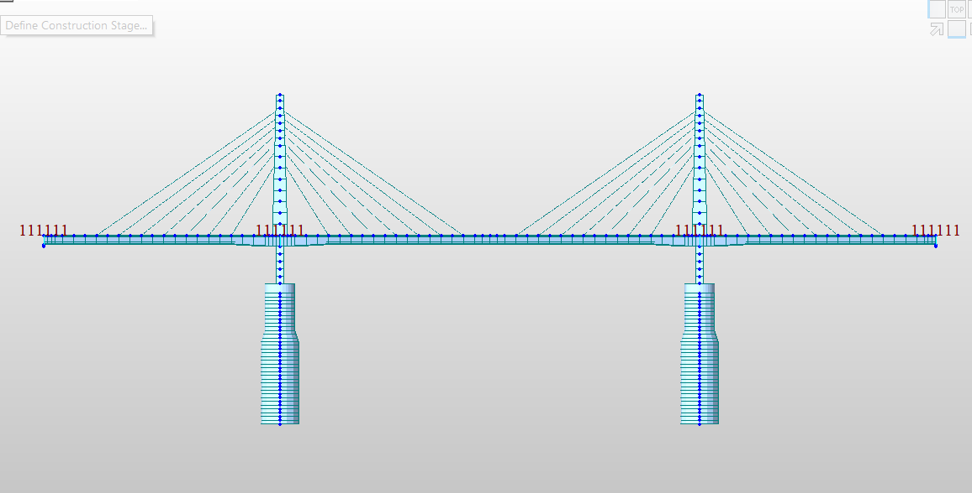
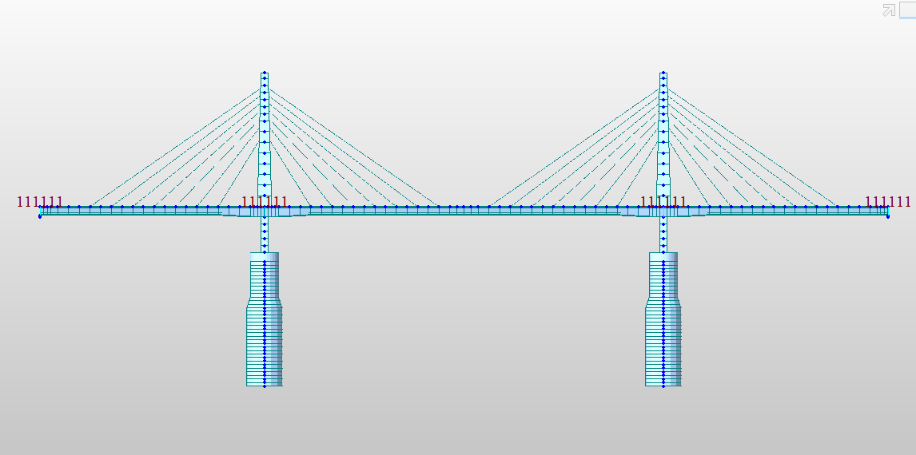
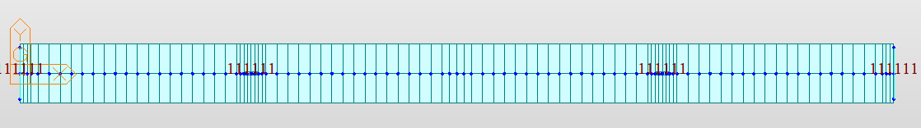
9. MODELING IN MIDAS CIVIL
Z
9.1 IN MIDAS CIVIL
UCS IN MIDAS
Upper pylon
Y
X
ISOMETRIC VIEW
BACK VIEW
FRONT
TOP VIEW

Slide 24
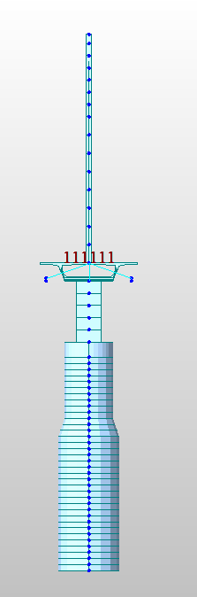
9.2 CONSTRAINTS PROVIDED IN THE BRIDGE
Elastic link – for bearings
- for foundation
Rigid link - between the lower pylon and pie table.
LEFT VIEW
RIGHT VIEW

Slide 25
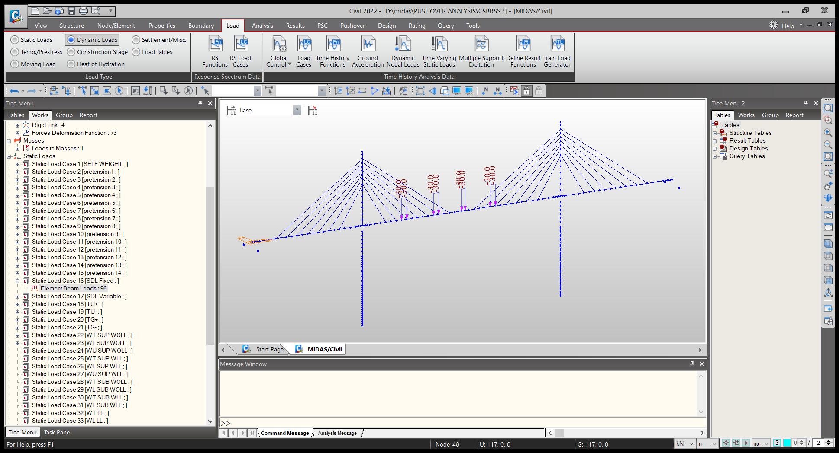
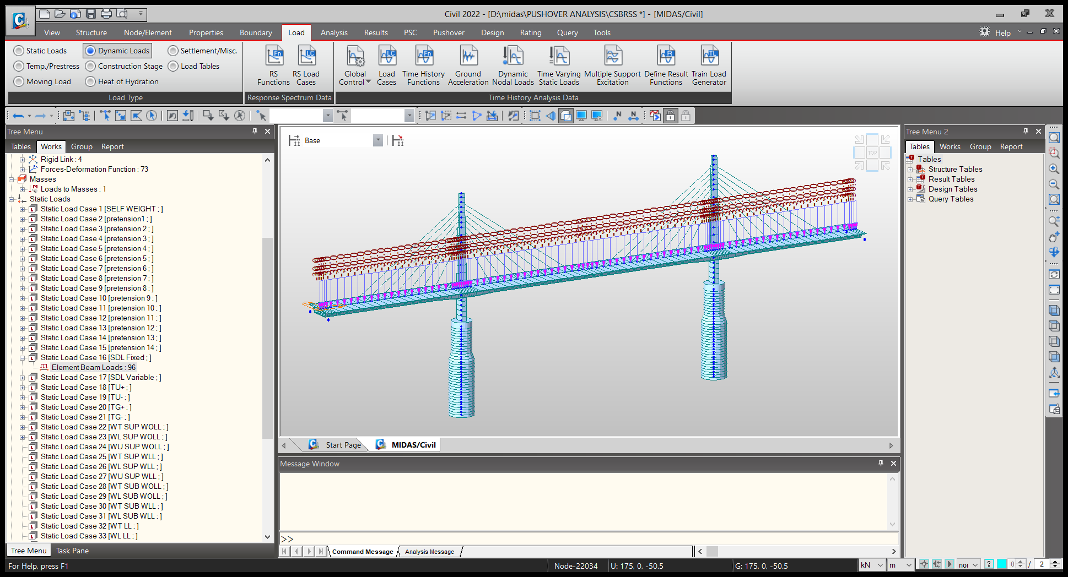
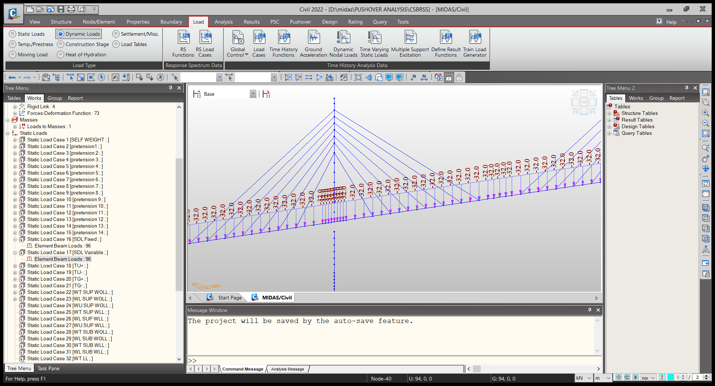
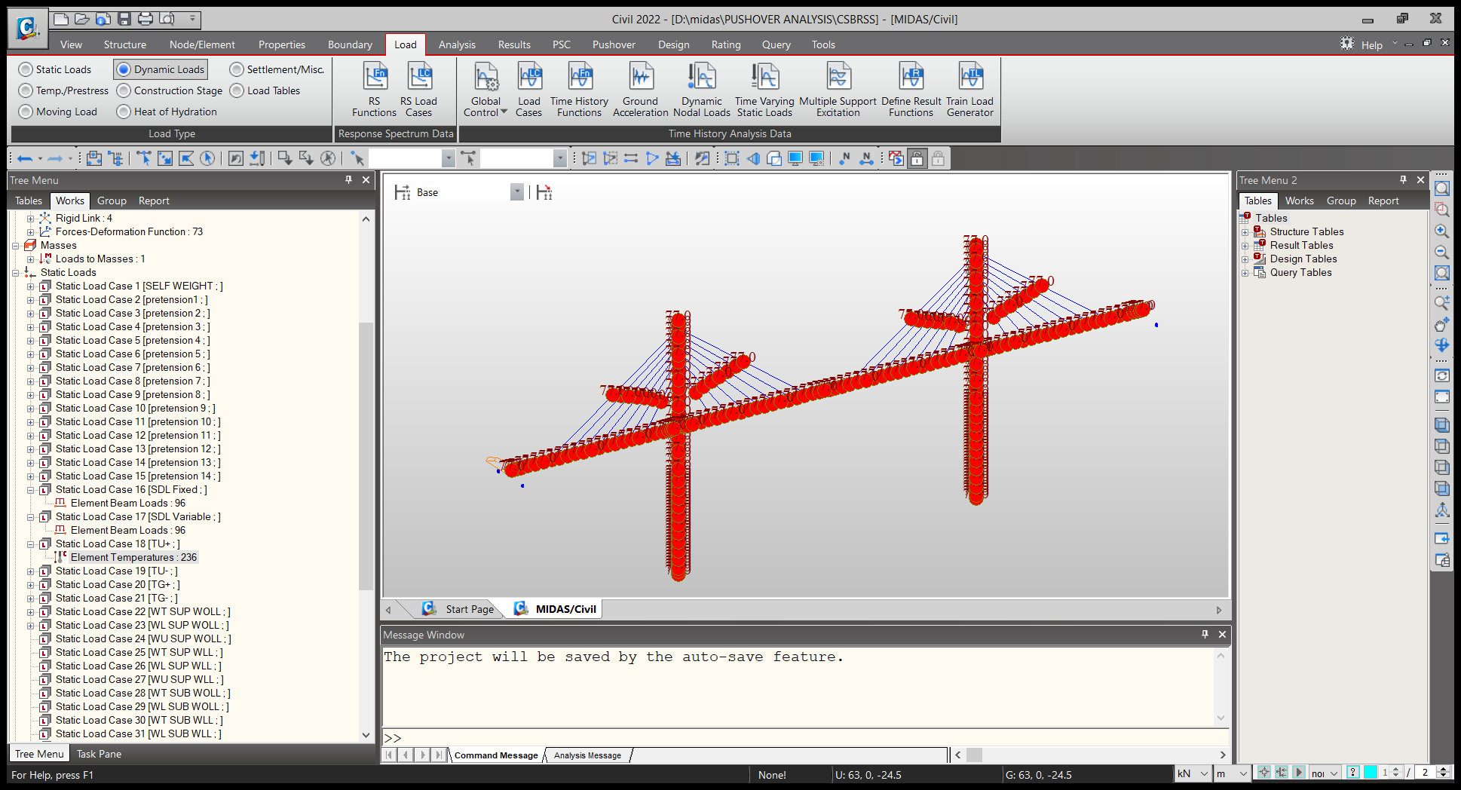
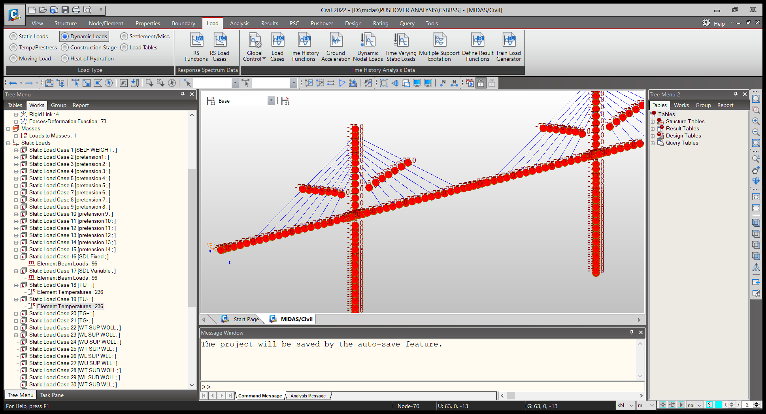
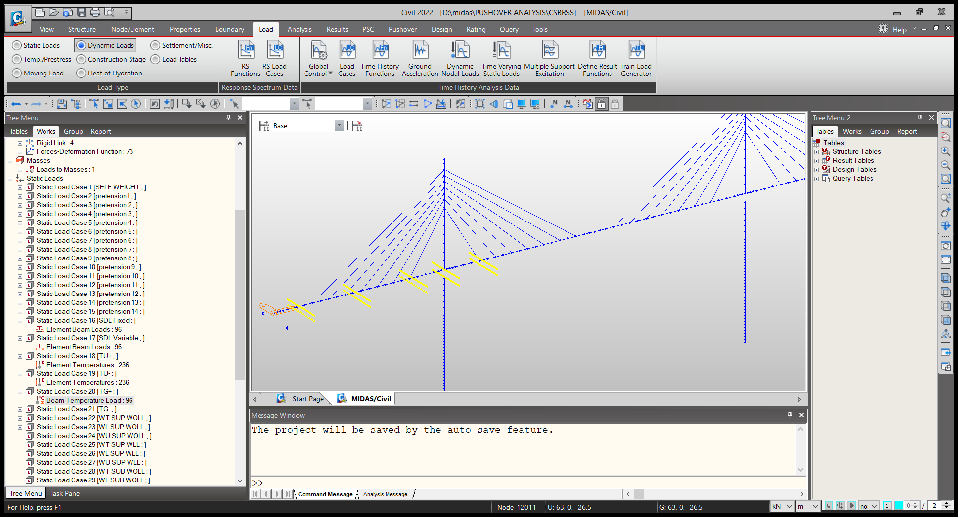
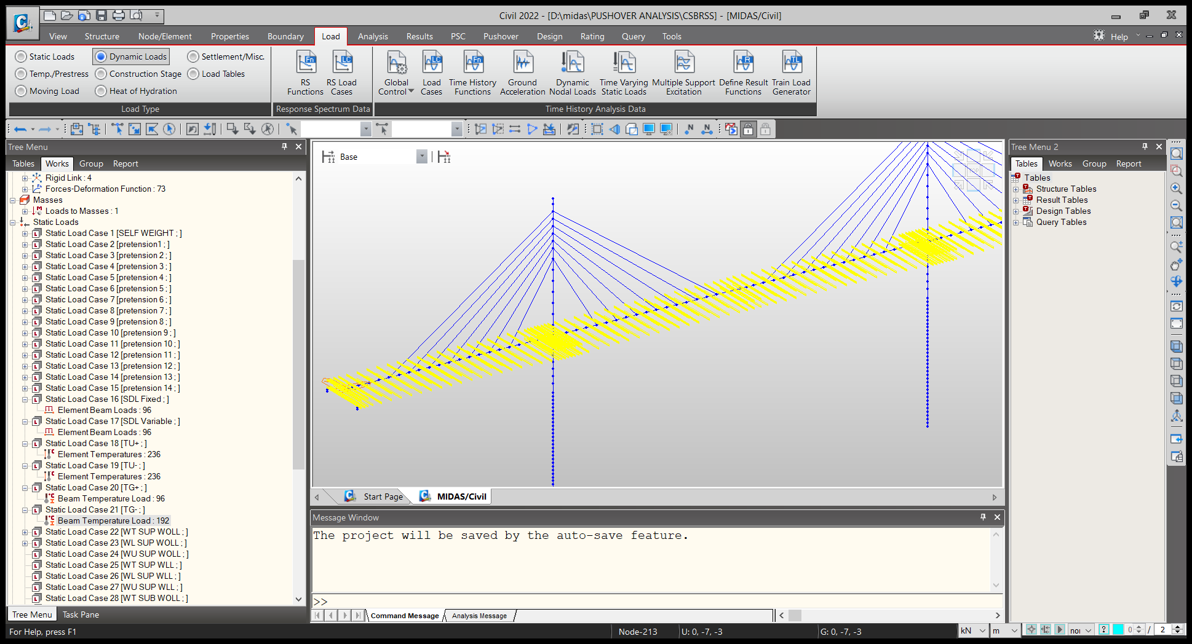
9.2 LOADING ON BRIDGE MODEL
SIDL FIXED
SIDL VARIABLE
TU+
TU-
TG+
TG-

Slide 26
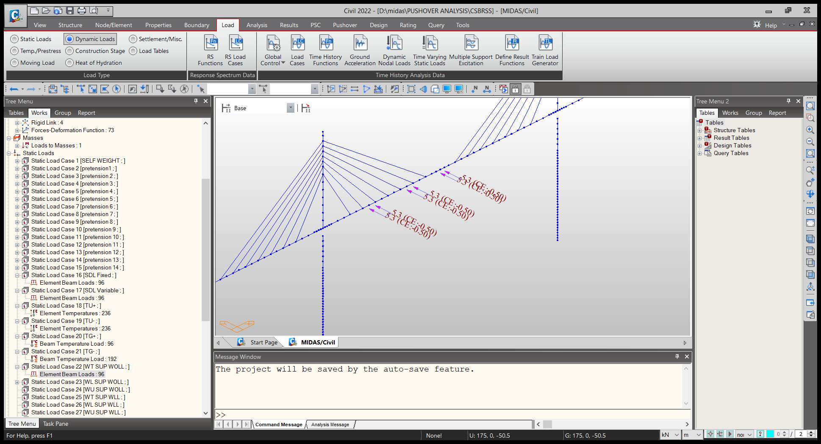
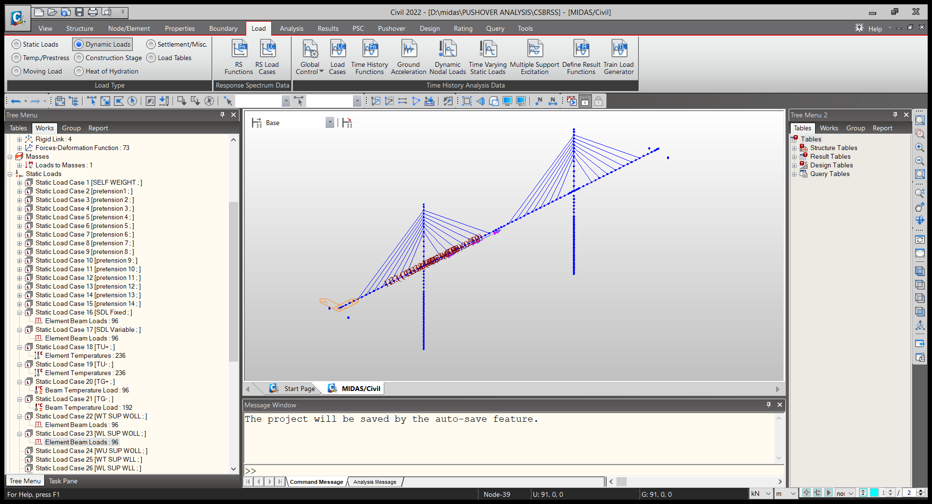
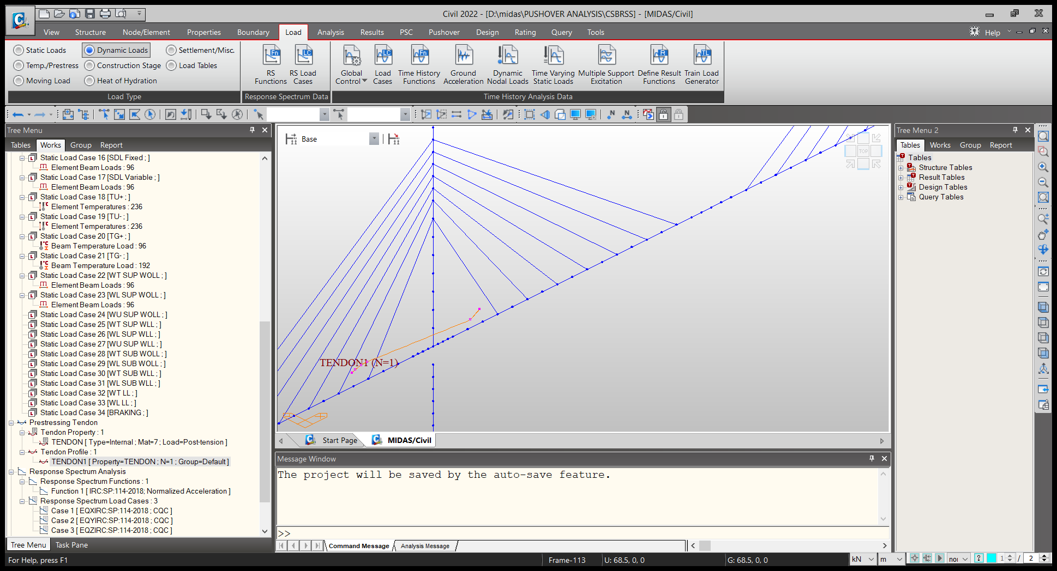
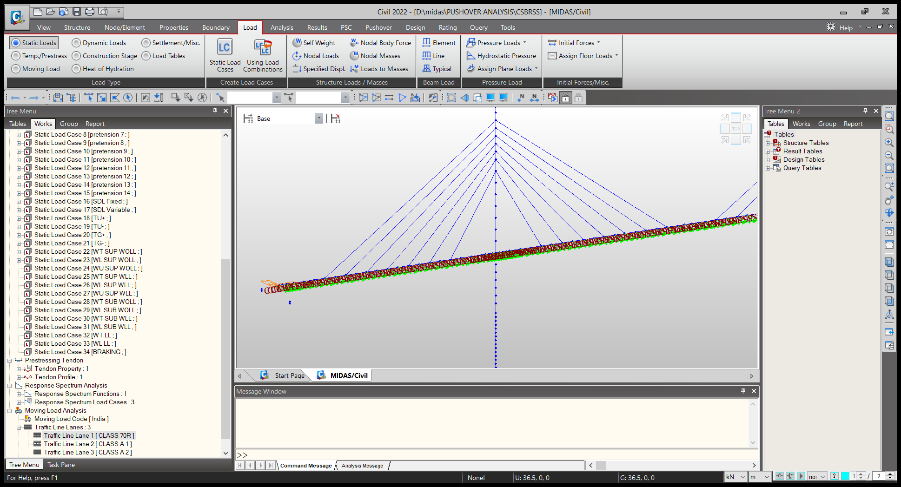
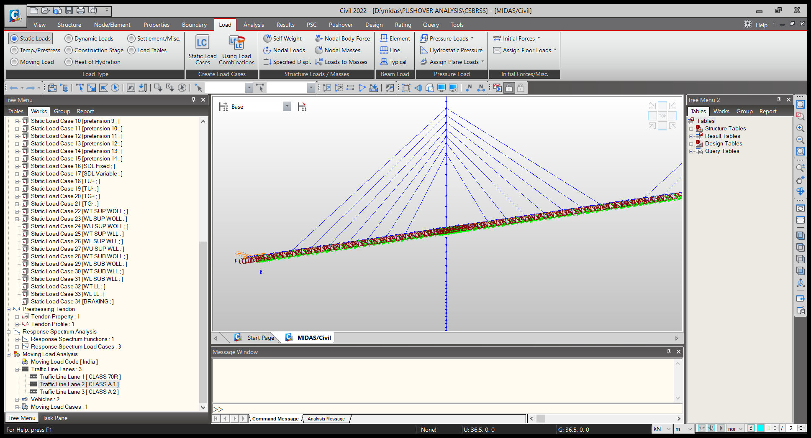
WT SUP WOLL
WL SUP LOL
PRETESNIO ON TENDON
TRAFFIC LINE LANE CLASS 70R
LANE 1 CLASS

Slide 27
10. ANALYSIS
STATIC ANALYSIS
STATIC NONLINEAR
PUSHOVER ANALYSIS
ANALYSIS PERFORMED
DYNAMIC ANALYSIS
RESPONSE SPECTRUM
CONSTRUCTION STAGE ANALYSIS

Slide 28
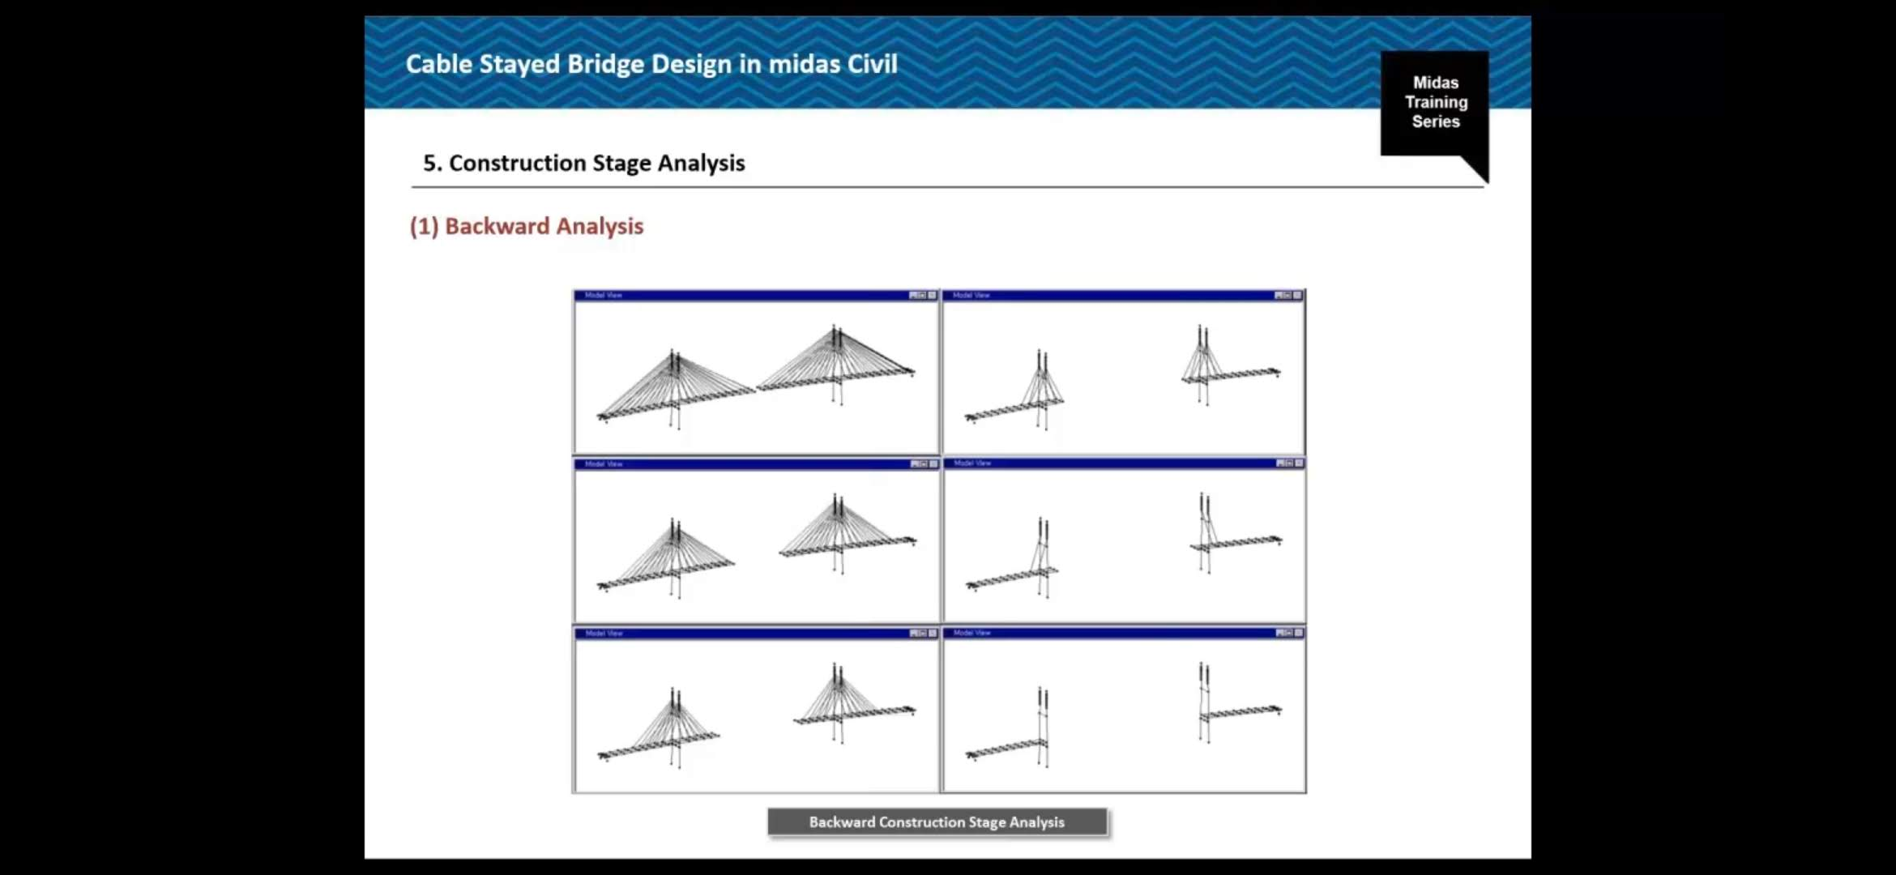
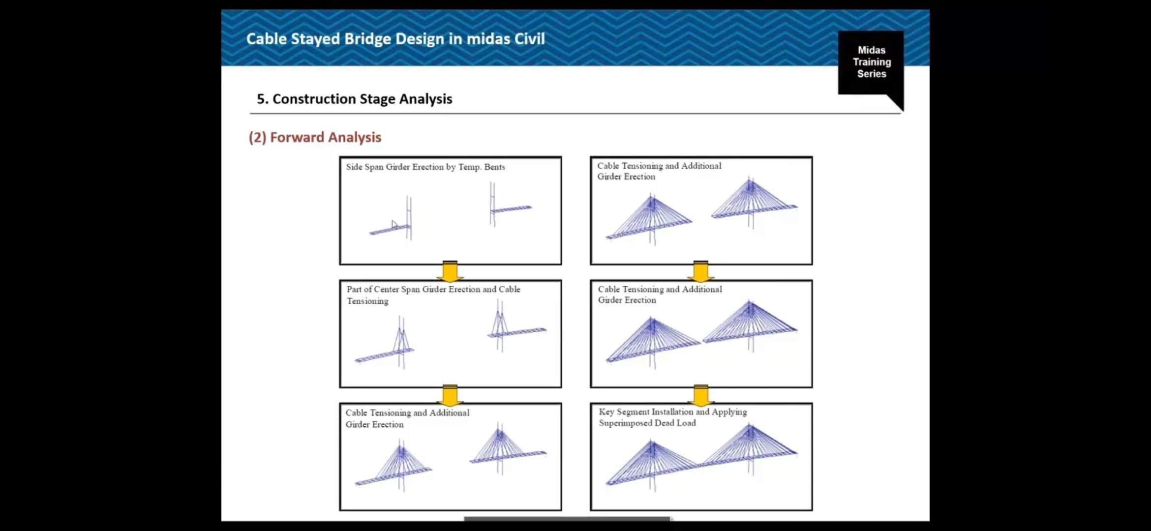
10.1 CONSTRUCTION STAGE ANALYSIS
Construction stage analysis in Midas Civil is performed to accurately simulate real-world construction processes and understand how structures behave at different stages of construction.
BACKWARD ANALYSIS
FORWARD ANALYSIS
Useful in finding cable force during execution
Does not account for time-dependent effects
Useful to confirm backward analysis results when creep and shrinkage are not considered.
Can account for the time-dependent effects.

Slide 29
10.2 PUSHOVER ON STRUCTURE
1
2
3
4
5
1
Yielding
Point of collapse
n x F
W
FORCE (F)
OVERALL PROCEDURE
DISPLACEMENT ( )
DONE
CAPACITY > DEMAND?
Develop a structural model.
Perform elastic RSA for displacement demand.
Perform Pushover Analysis for displacement capacity.

Slide 30
10.5 METHOD OF DETERMINATION OF CABLE FORCES
Initial Cable Forces
(1) Traditional "Zero Displacement" Method
(2) Force Equilibrium Method
(3) Force Method
(4) Unknown Load Factor in Midas Civil
(5) Tuning of Cables

Slide 31
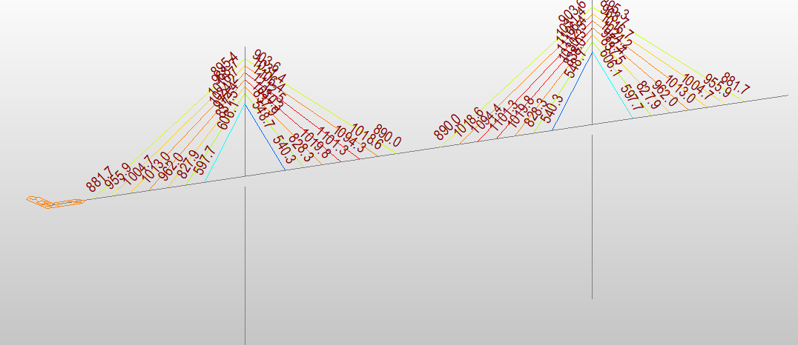
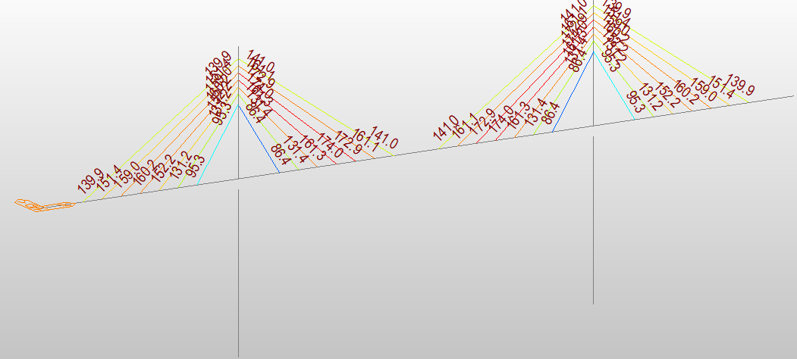
11.0 RESULTS
Results after analysis
11.1 Forces in cables
Self weight
SIDL fixed

Slide 32
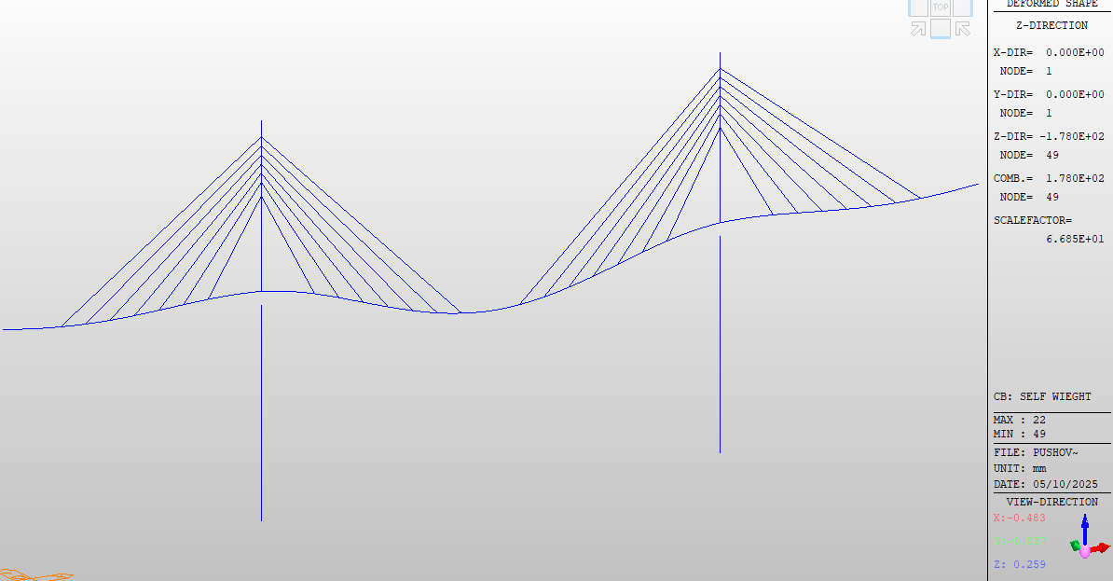
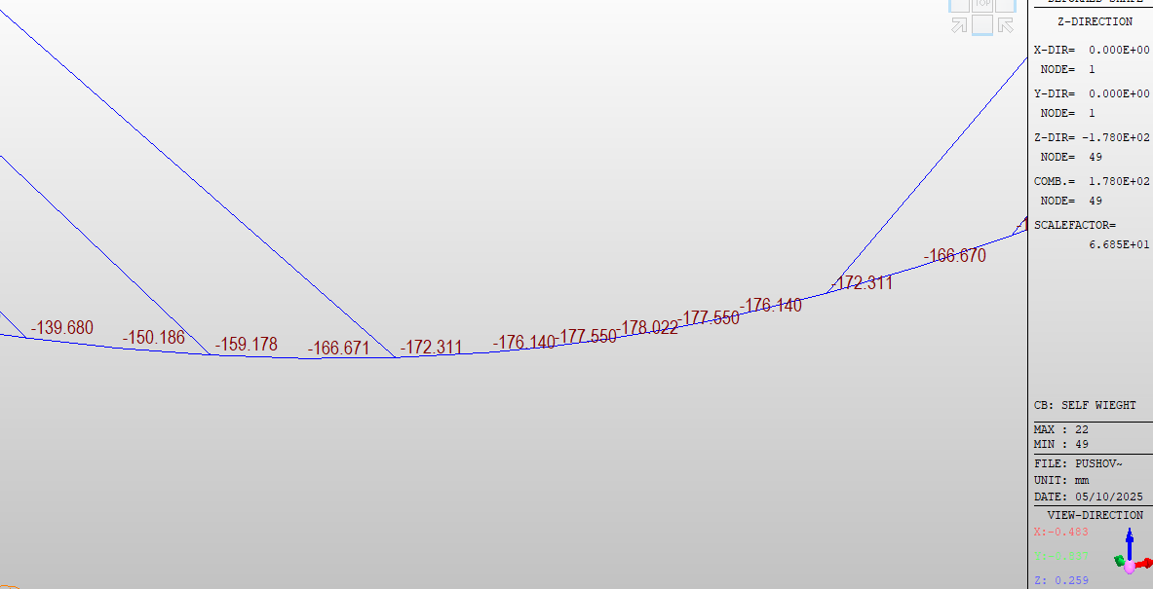


11.2 DEFLECTIONS IN CABLE BRIDGE
Maximum displacement = 176.140 mm
Self weight
SIDL fixed
SIDL variable

Slide 33

11.3 REACTIONS

Slide 34












11.4 CONSTRUCTION STAGE ANALYSIS
Total 22 stages of construction is considered in Midas.

Slide 35












Slide 36


11.4.2 Forces in cables after the construction stage analysis
Self-weight
SIDL fixed

Slide 37

11.5 RESULTS OF PUSHOVER ANALYSIS.
Maximum displacement = 260mm

Slide 38

12. CHECKS
12.1 STRENGTH
12.2 SERVICABILITY
Shear
Moment
Stability
Sliding
Stresses
Interaction checks
1. FOR DEFLECTION
Mid tower displacement less or equal $\frac{H}{350}$
Deck displacement less or equal $\frac{L}{540}$
2. FOR CRACK WIDTH
LIMITING CRACK WIDTH IS = 0.3mm

Slide 39
13. DESIGNS
13.1 STRUCTURAL ELEMENTS ARE DESIGNED
1. Cable
2. Tendon
3. PSC box girder
4. Sections for the upper and lower pylons
5. Well foundation design
6. Design of an elastomer bearing

Slide 40
13.2 DESIGN OF CABLE
No of strands 37
Area = 140 mm2
Stress = 1860 n/mm2
Stress 45 percentage = 1860 x 0.45 = 837 Mpa
35 dead load 10 live load 1860 x 0.1 = 186 MPa
1860 x 0.35 = 651 Mpa
Ultimate capacity = 651 x 5100 mm2 = 3300 KN

Slide 41


13.3 PSC BOX GIRDER
SHEAR
MOMENT
TORSION
COMBINED EFFECTS.

Slide 42



13.4 DESIGN OF TENDON IN DECK
The seven-wire strand

Slide 43


13.5 ELASTOMERIC BEARING DESIGN

Slide 44



13.6 ELASTOMERIC BEARING DESIGN
3000 mm
4000 mm

Slide 45



13.7 WELL FOUNDATION DESIGN
STABILITY CHECK
SLIDING CHECK

Slide 46


14. DETAILING
14.1 PLAN OF WELL STEINING
14.2 WELL CUTTING EDGE

Slide 47




Slide 48
15. REFERENCES.
• IRC: 112- 2020, Code of Practice for Concrete Road Bridges (Limit State Design), Indian Roads Congress, New Delhi.
• IRC:136, Guidelines for the Design, Construction and Maintenance of Cable-Stayed Bridges, Indian Roads Congress, New Delhi.
• IRC:6-2017, Standard Specifications and Code of Practice for Road Bridges, Section II – Loads and Stresses, Indian Roads Congress, New Delhi.
• IRC:18-2010, Design Criteria for Prestressed Concrete Road Bridges (Post-tensioned System), Indian Roads Congress, New Delhi.
• IS: 1343- 2012, Code of Practice for Prestressed Concrete, Bureau of Indian Standards, New Delhi.
• IRC:83 (Part I & II), Specifications and Guidelines for Bearings for Road Bridges, Indian Roads Congress, New Delhi.
• IRC: SP:114-2018, Guidelines for Seismic Design of Road Bridges, Indian Roads Congress, New Delhi.
• IRC:45-1972, Recommendations for Estimating the Resistance of Soil Below the Maximum Scour Level in the Design of Well Foundations, Indian Roads Congress, New Delhi.
• IS: 3955- 1967, Criteria for Design of Well Foundations, Bureau of Indian Standards, New Delhi.

Slide 49
THANK YOU

